Slide 1

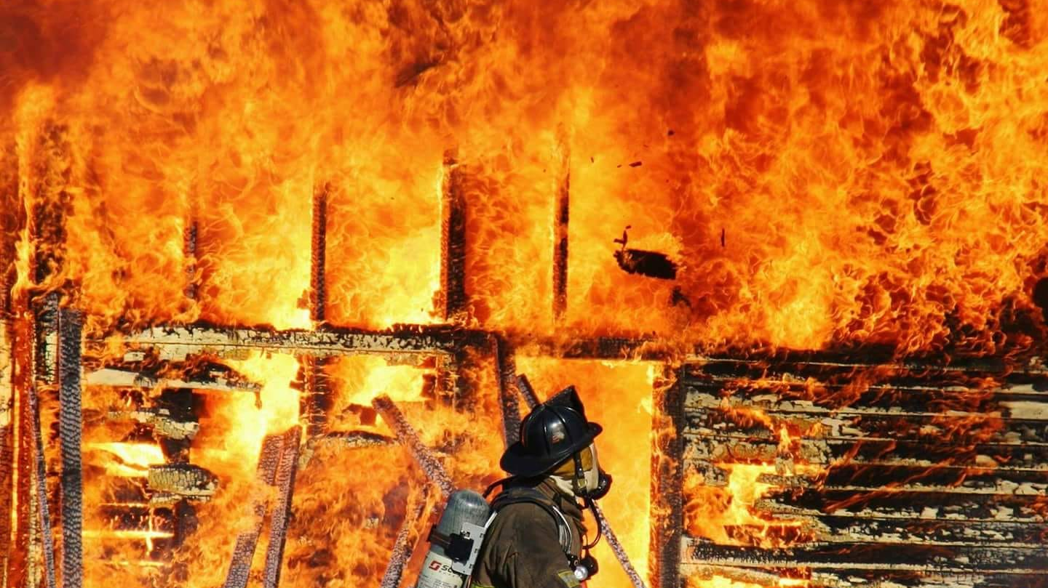

Tega Cay Fire

Slide 2

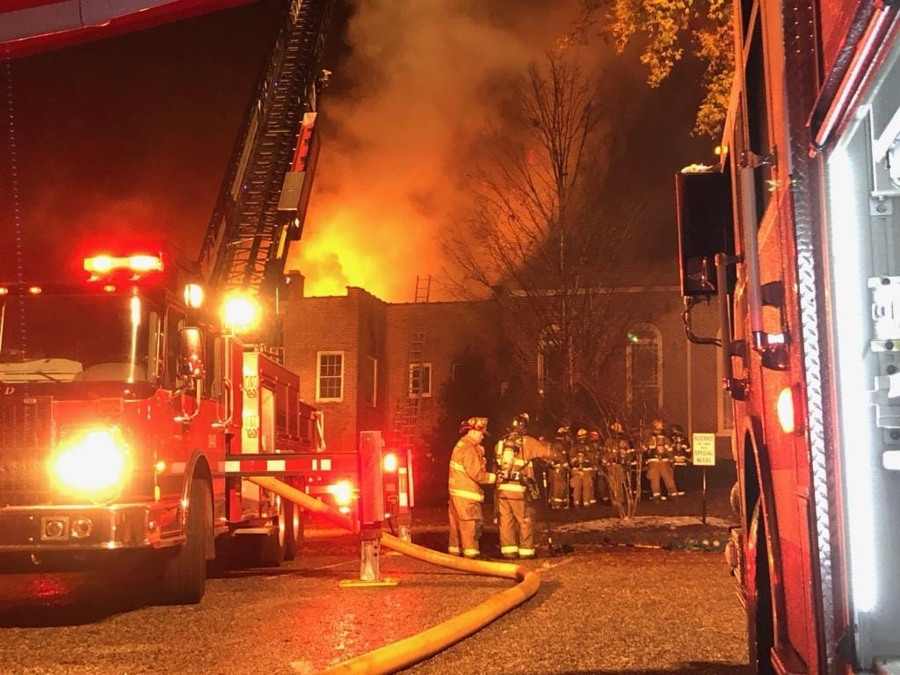
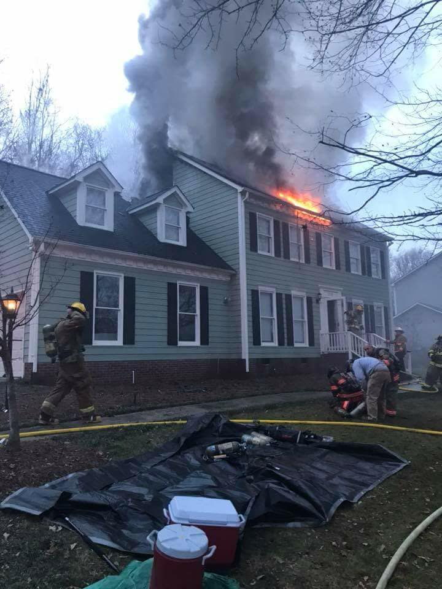
Response Stats
False Alarms | 64
Fire | 18
Good Intent | 98
Hazardous Condition | 12
Overpressure | 1
Rescue, EMS | 223
Service Call | 77
Special Event | 1
Weather Related Event | 0
YTD | 494

Slide 3
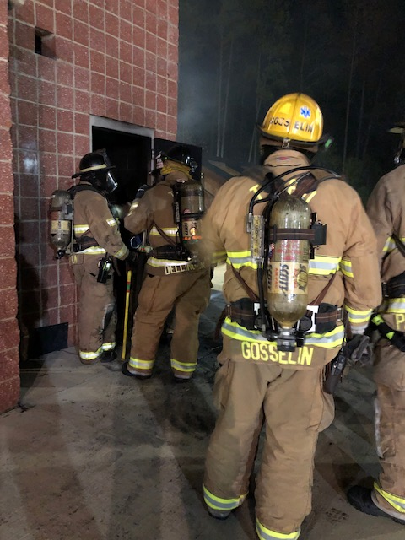
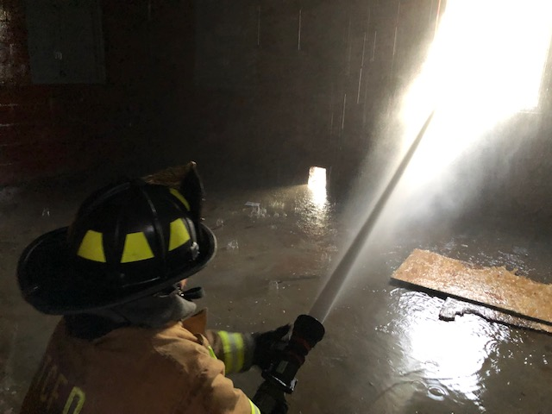
Training
Current Year Stats
  In 2019 the Tega Cay FD is on track to record over 3,000 training hours.
Projections for FY2020 per Firefighter
  Low Angle 16 Hours
  Confined Space 32 Hours
  ISO Compliant Class 1 Hours:
    Officer 12 Hours
    Company Level Training 192 Hours
    Hazmat 6 Hours
    Driver Operator 12 Hours
    Facility (Live Fire) 18 Hours
  EMT 24 Hours

Slide 4
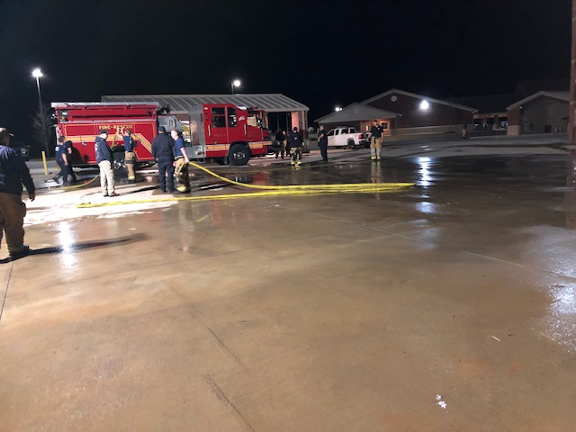
Initiatives
Events
EMS
Fire Response
Education
IAPs
Community Involvement
Training
  Software & Development of formal training plan to meet ISO 1.
  SCBA
  Rescue – Confined Space, Rope, Vehicle, Water

Slide 5
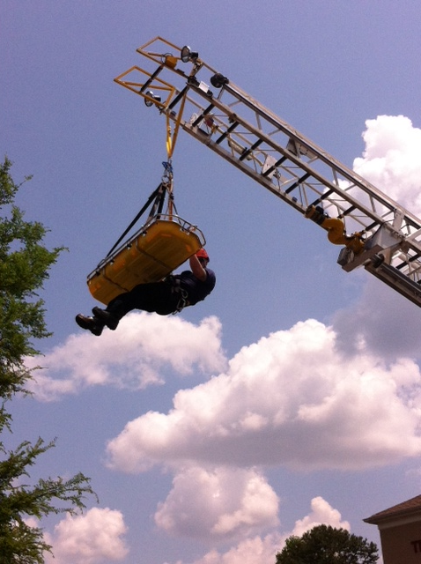
Initiatives
  ESO
  Mobile CAD (1st Quarter 2020)
    Safety of Fire Fighter – Info.
    Mapping
    Data Sharing
  Info Platform
    Operations and Administration
Preplan and Inspection Program
Knox Box Program
Station 2 Upfit
Sprinklers
Staffing
Promotions

Slide 6
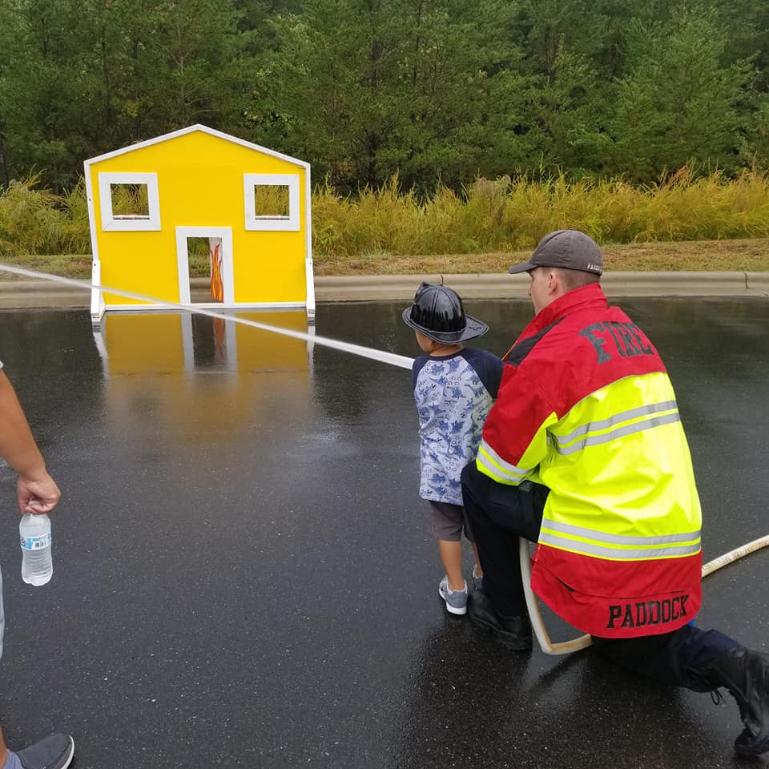
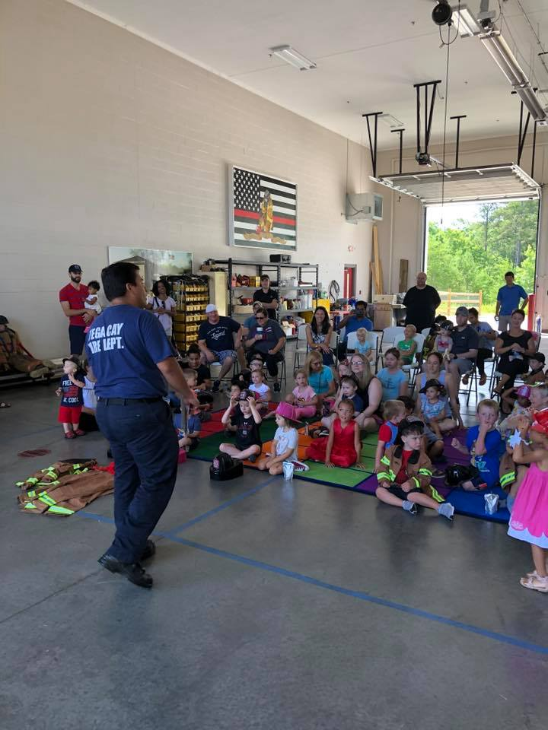
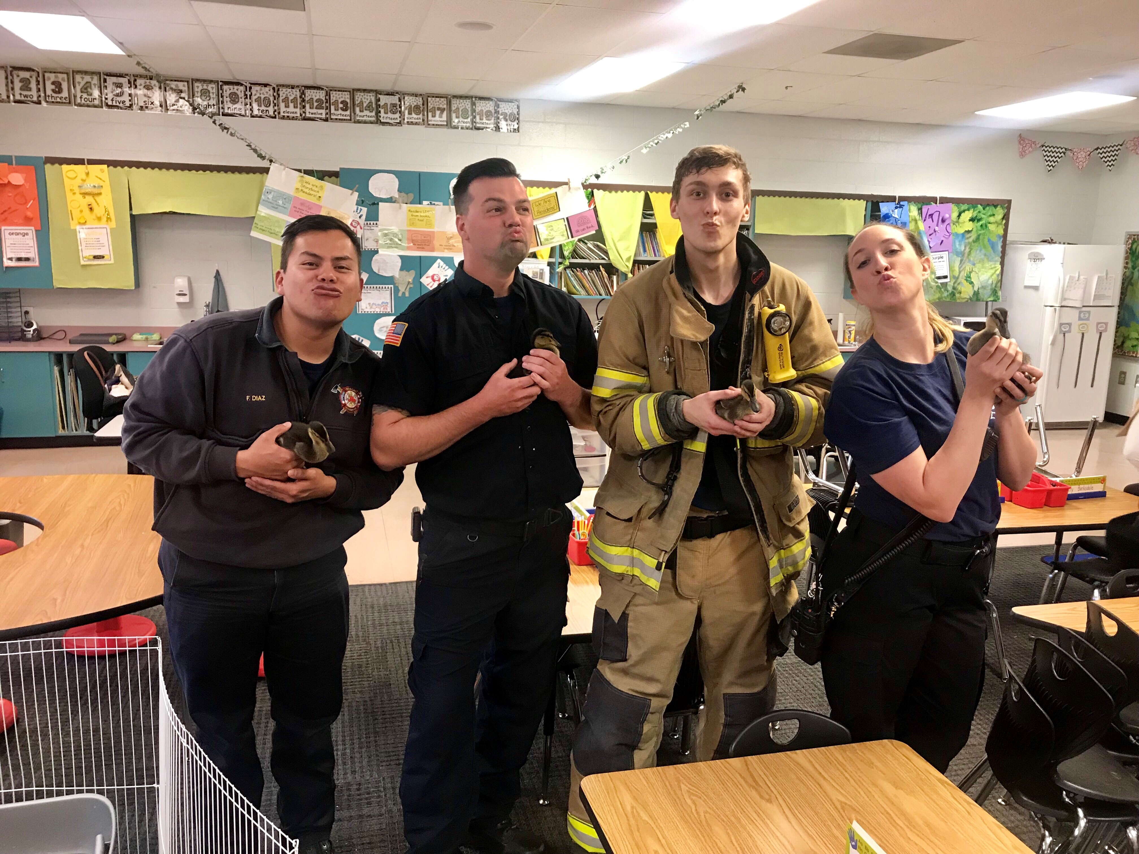
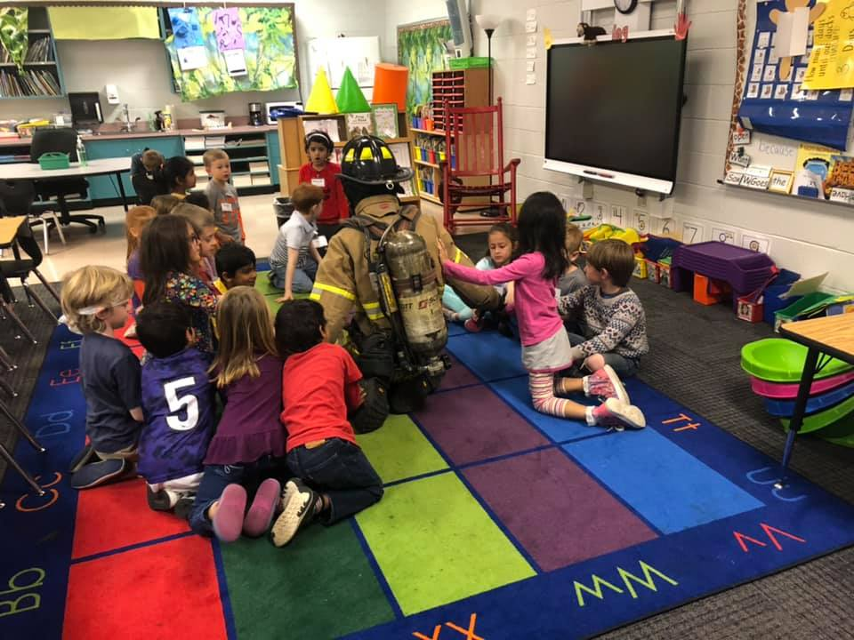
Education
Public Open House
Read, Interact & Educate the Public
Station Tours

Slide 7
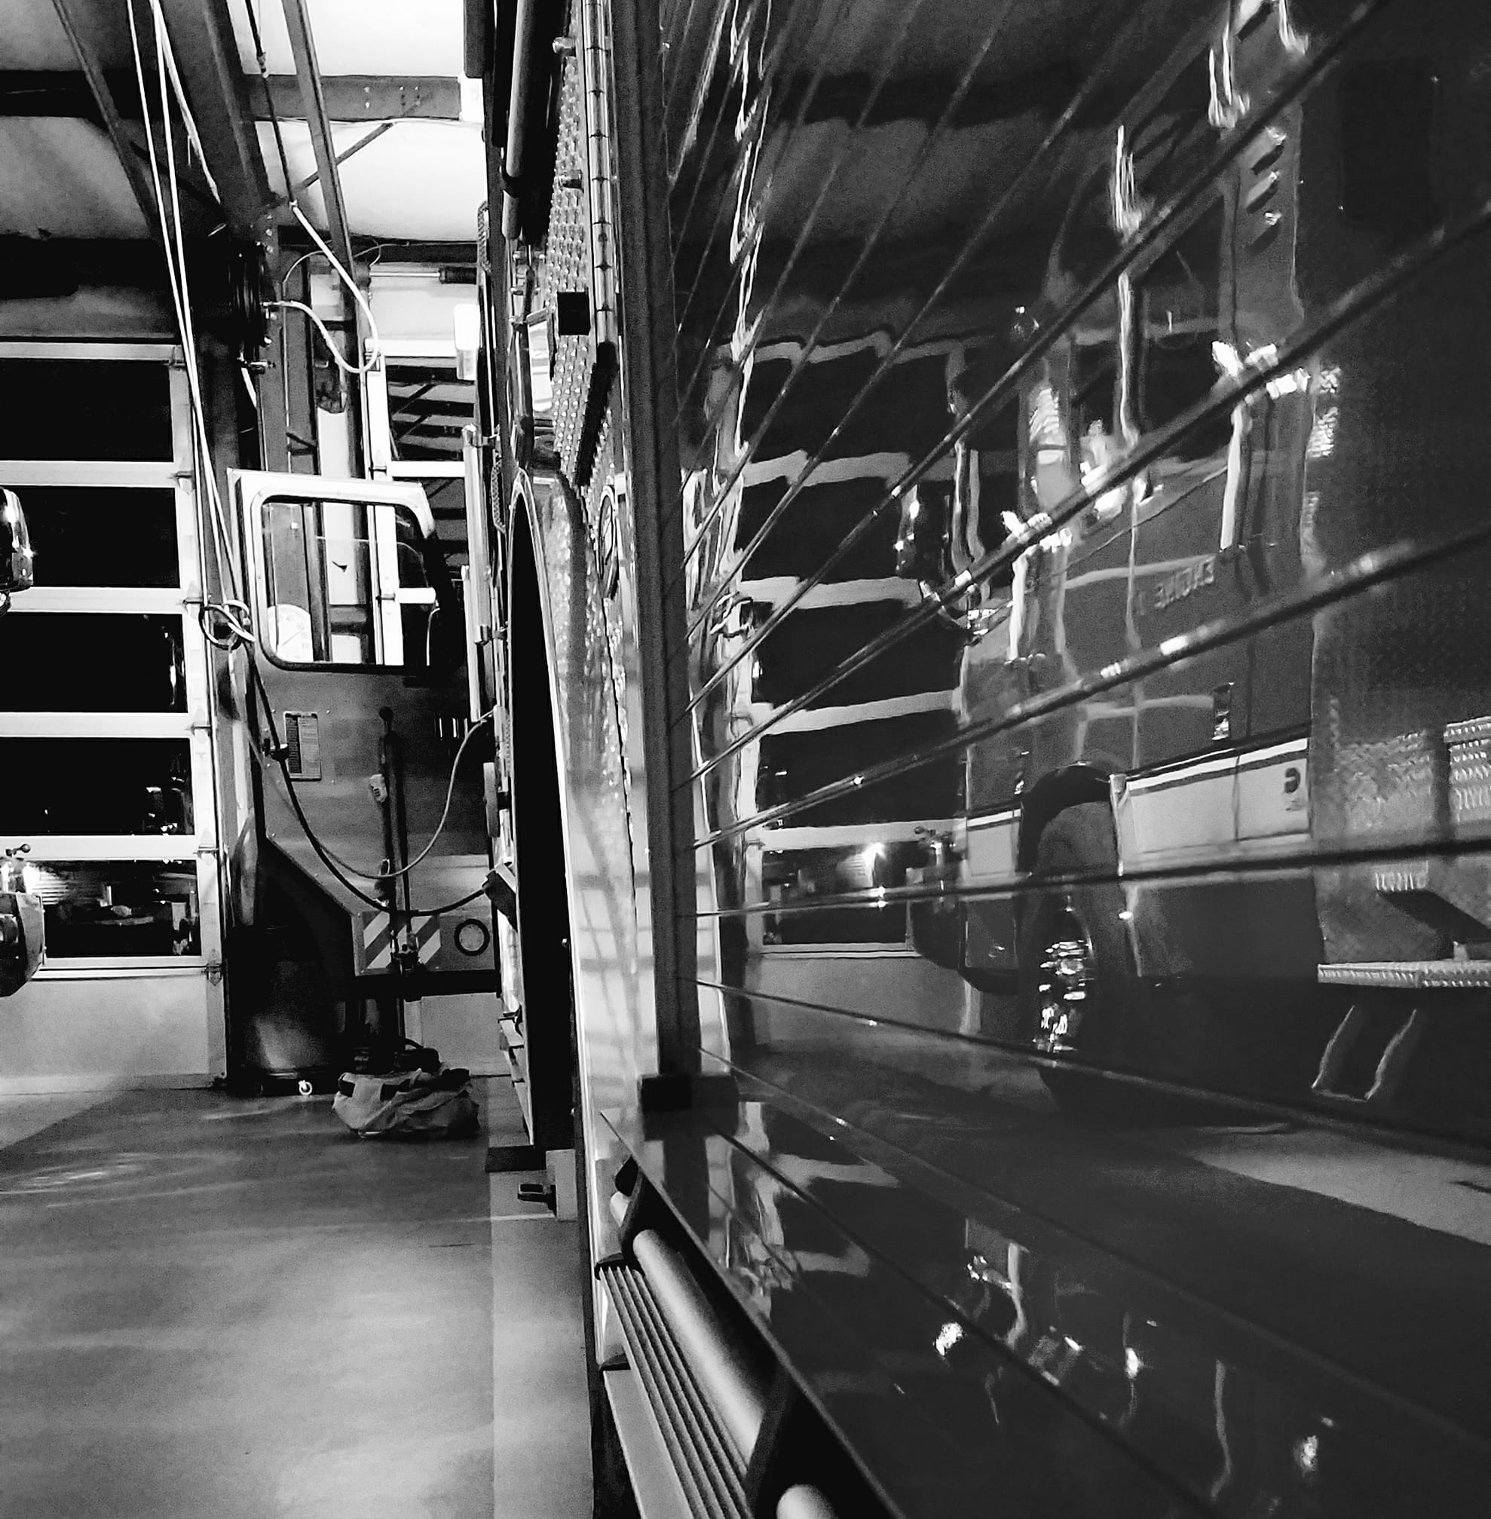
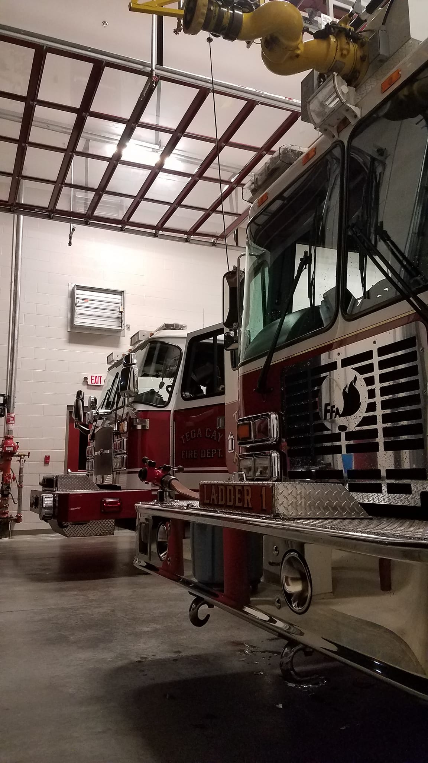
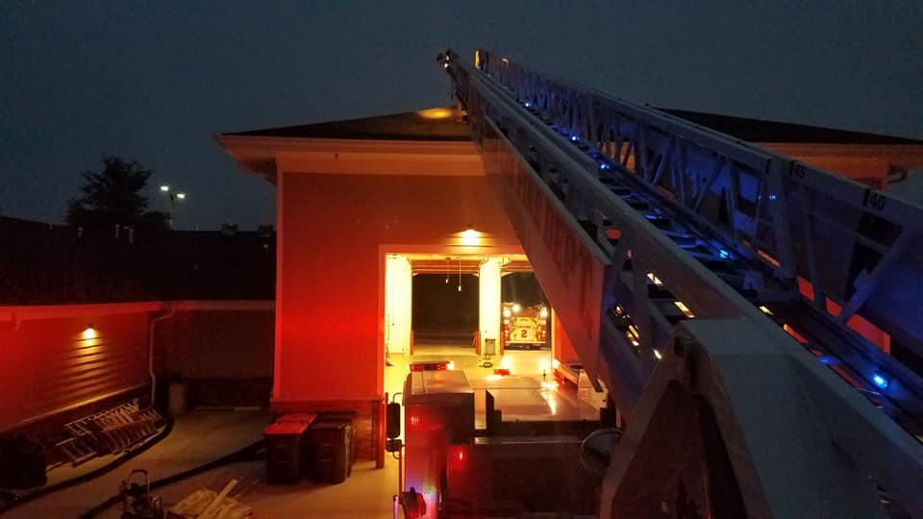
Equipment
Ladder 1 2007 HME Ferrara
Engine 1 2006 Pierce Quantum
Brush 1 2006 Ford F-350
Engine 2 2015 E-One
Engine 4 1991 Pierce Dash
Service 1 1993 Ford F800

Slide 8
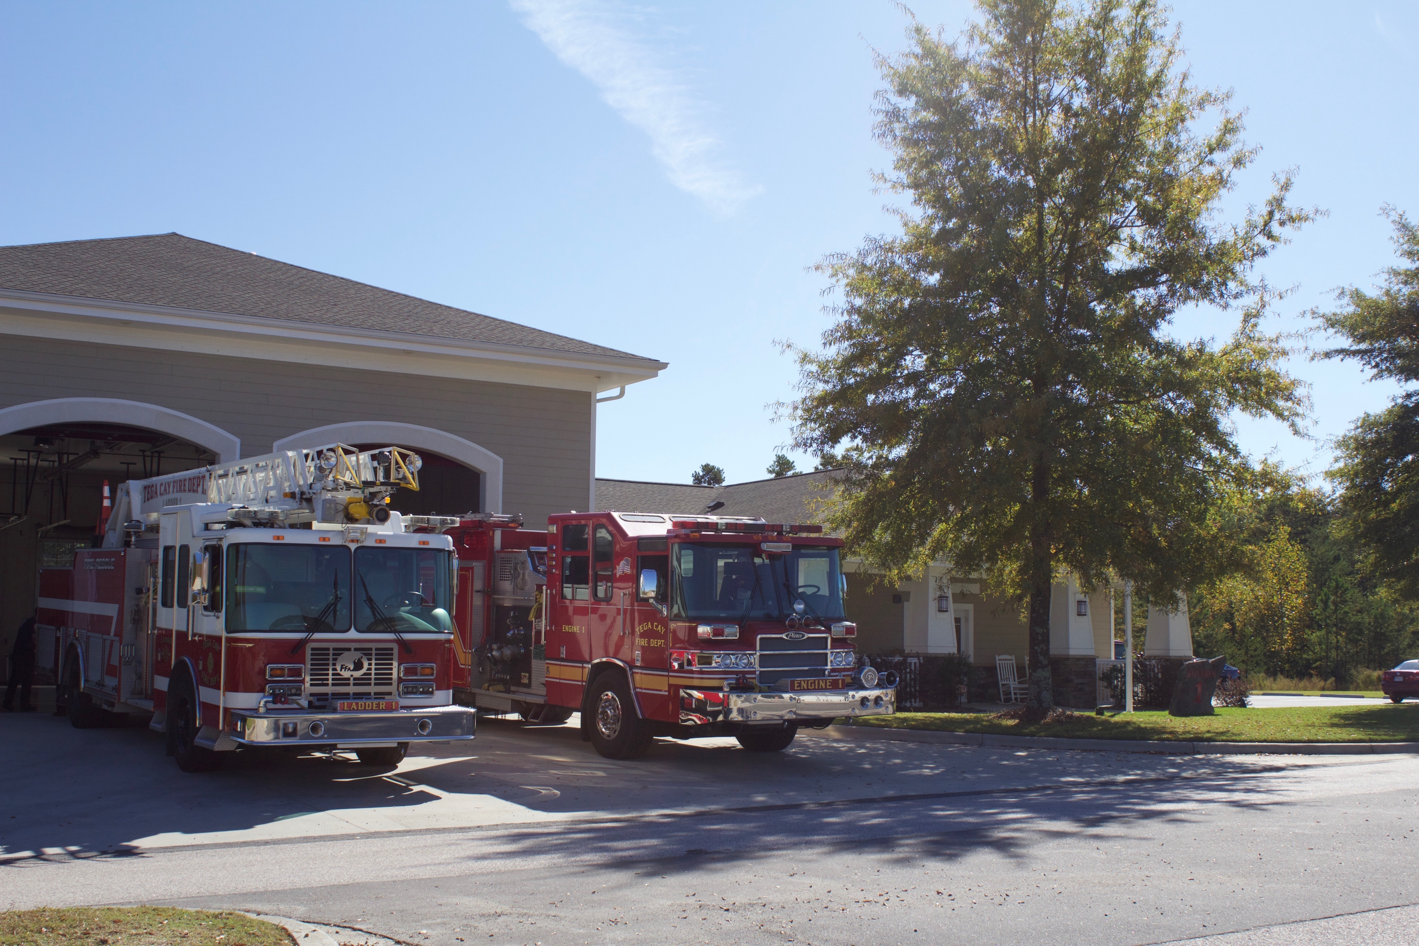
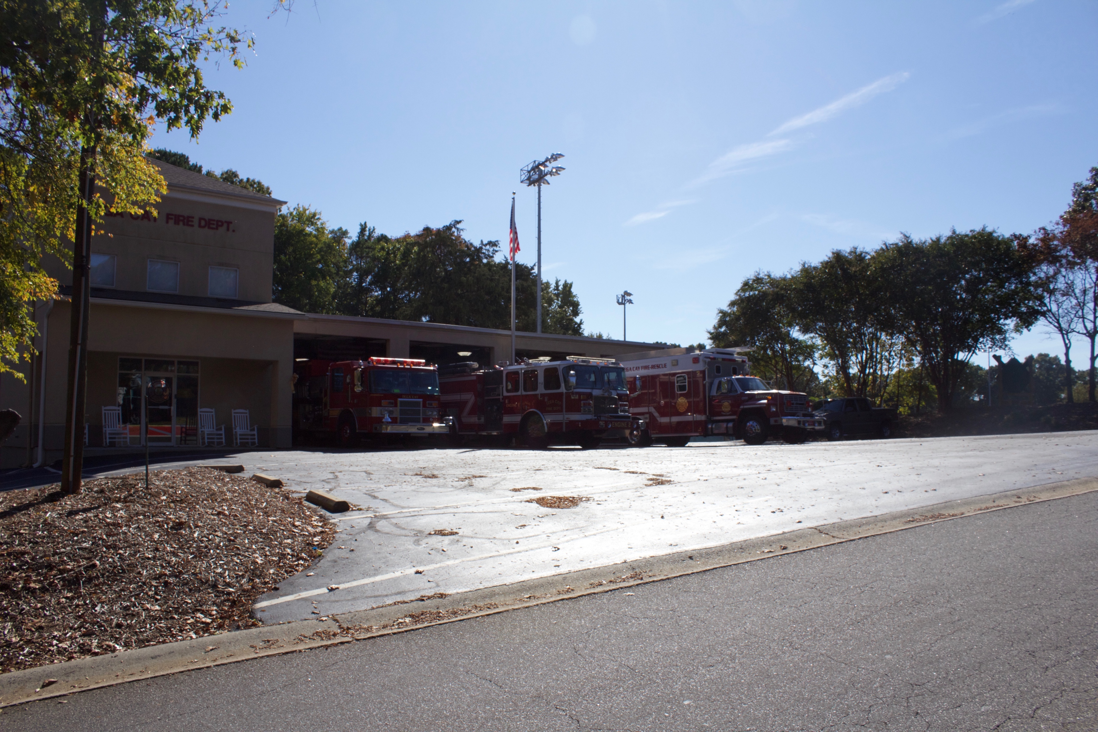
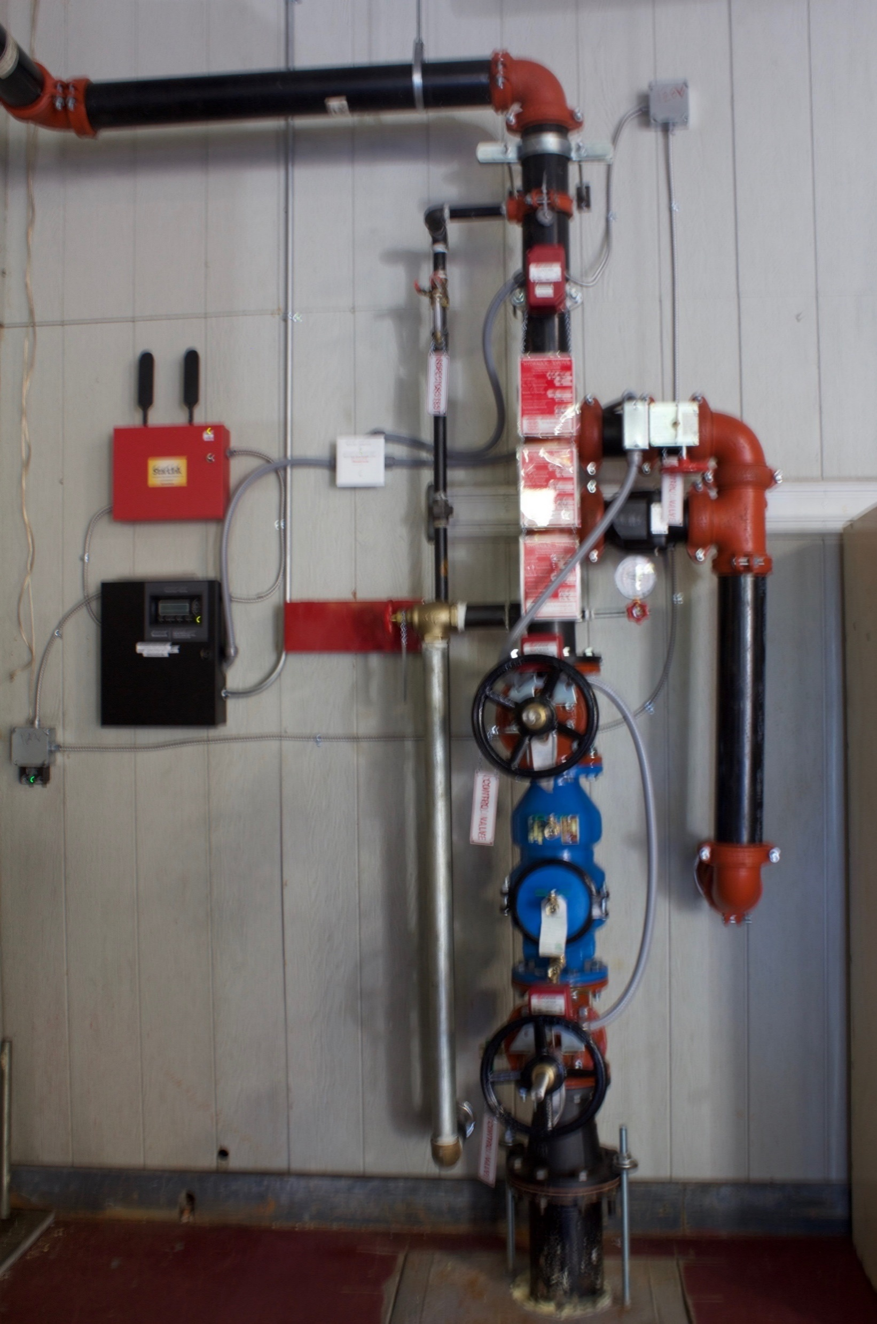
Stations
Station 1
Station 2
  1195 Stonecrest Blvd.
  Opened 2017
7200 Tega Cay Dr.
Opened in 1973

Slide 9
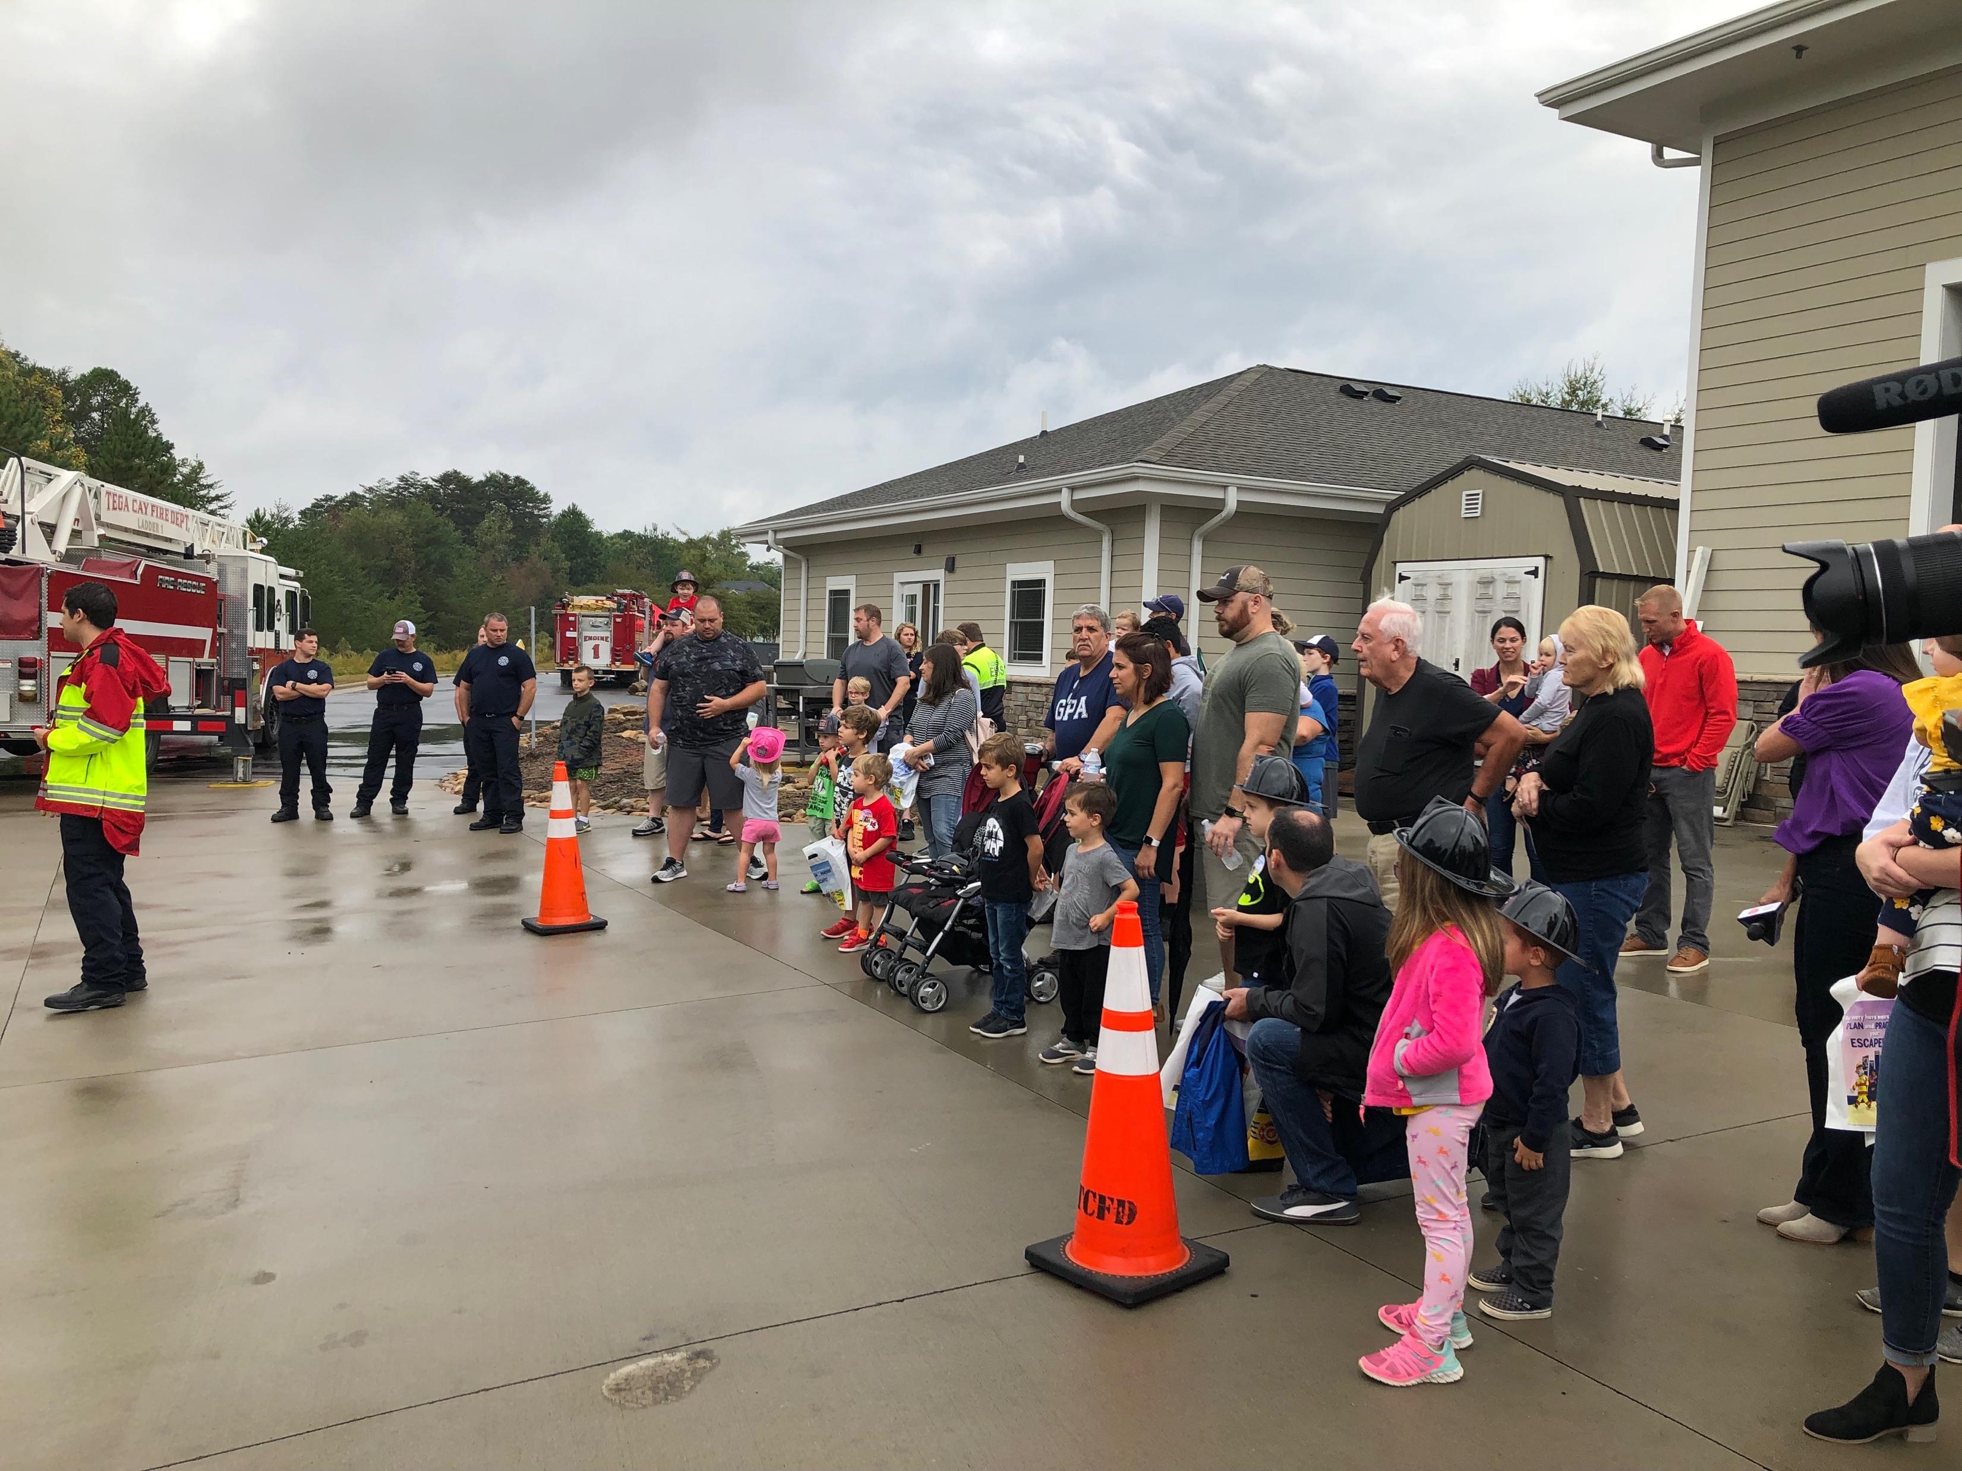
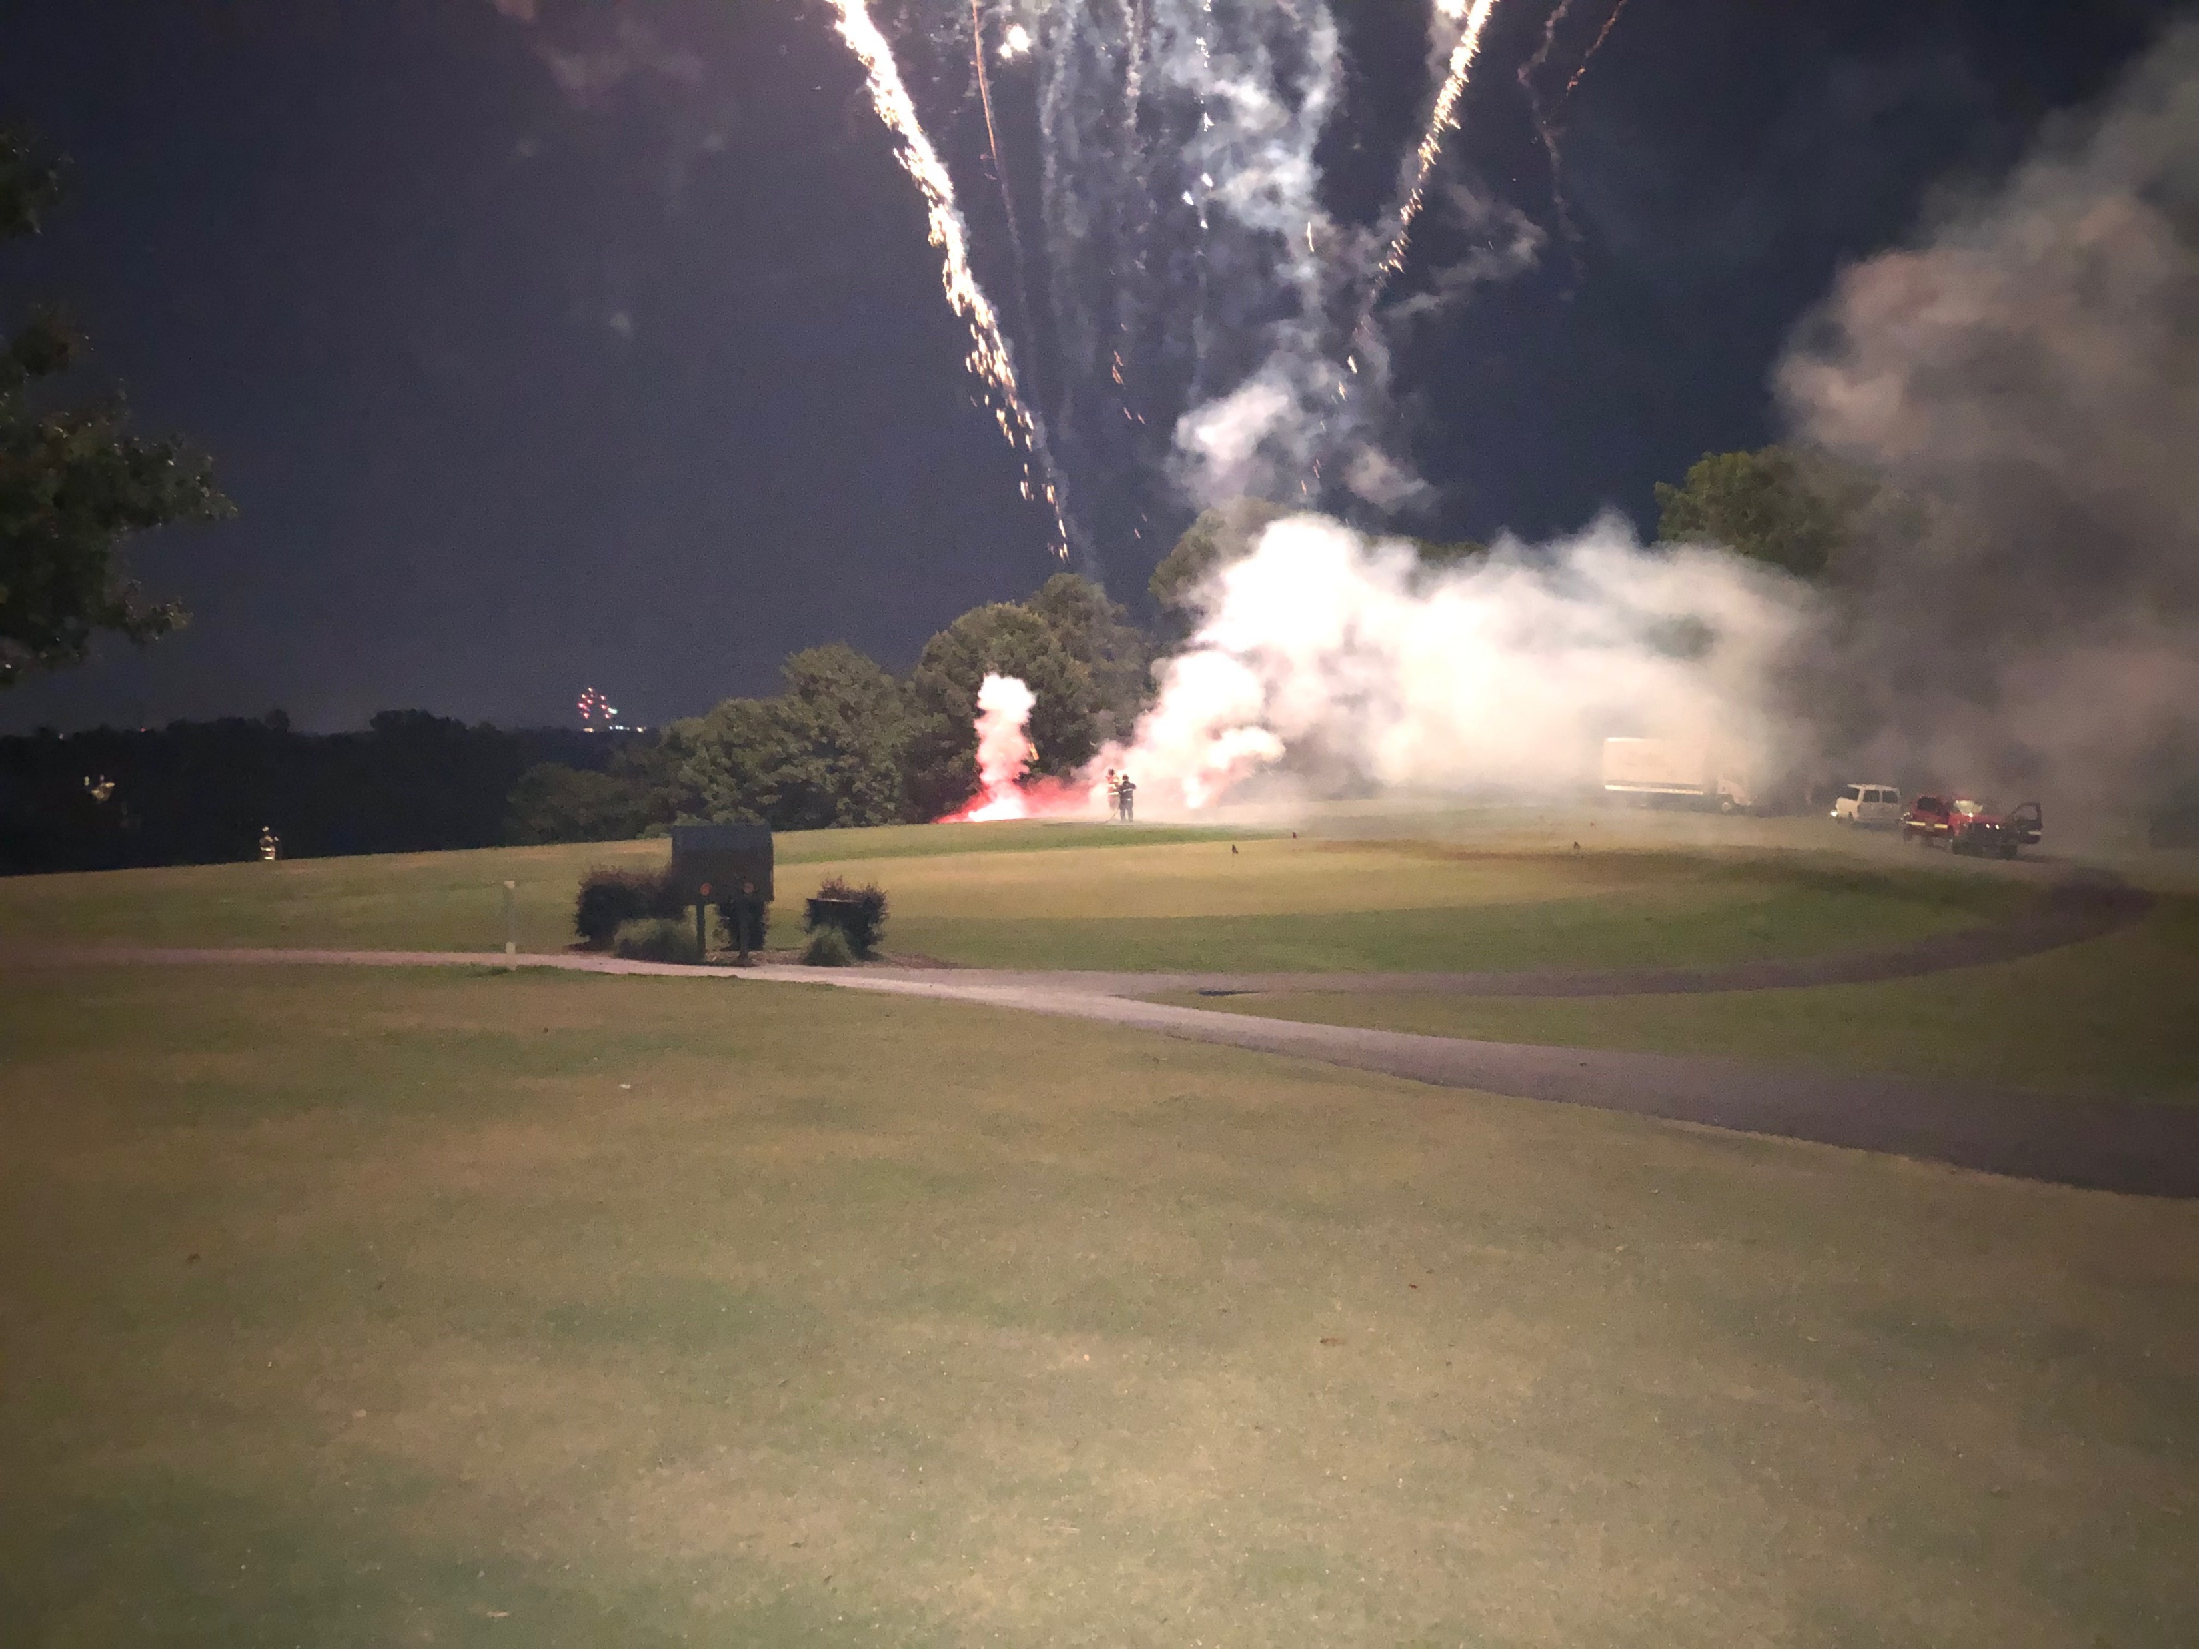
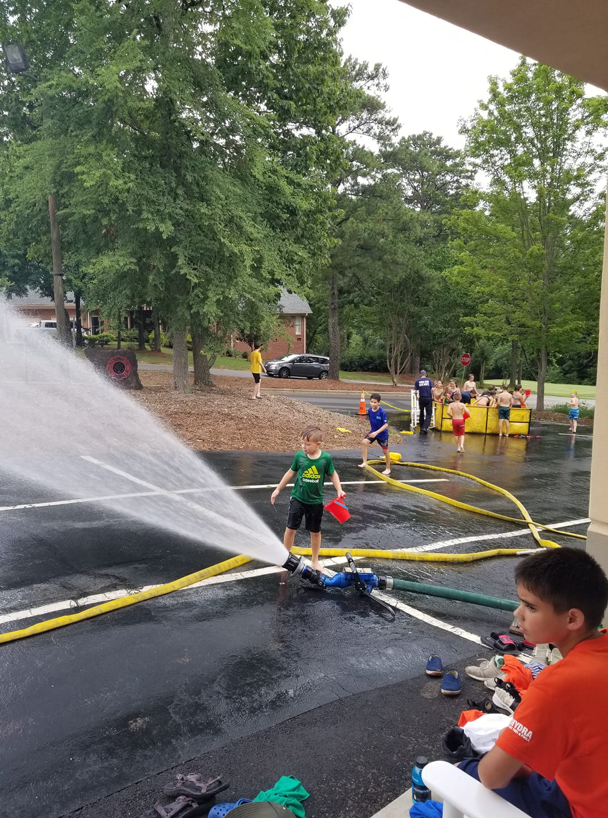
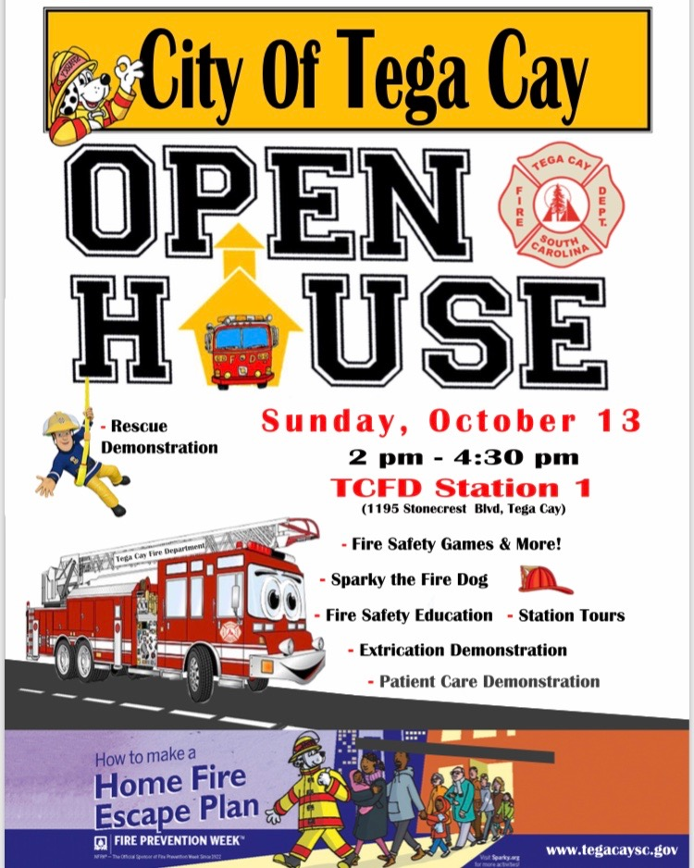
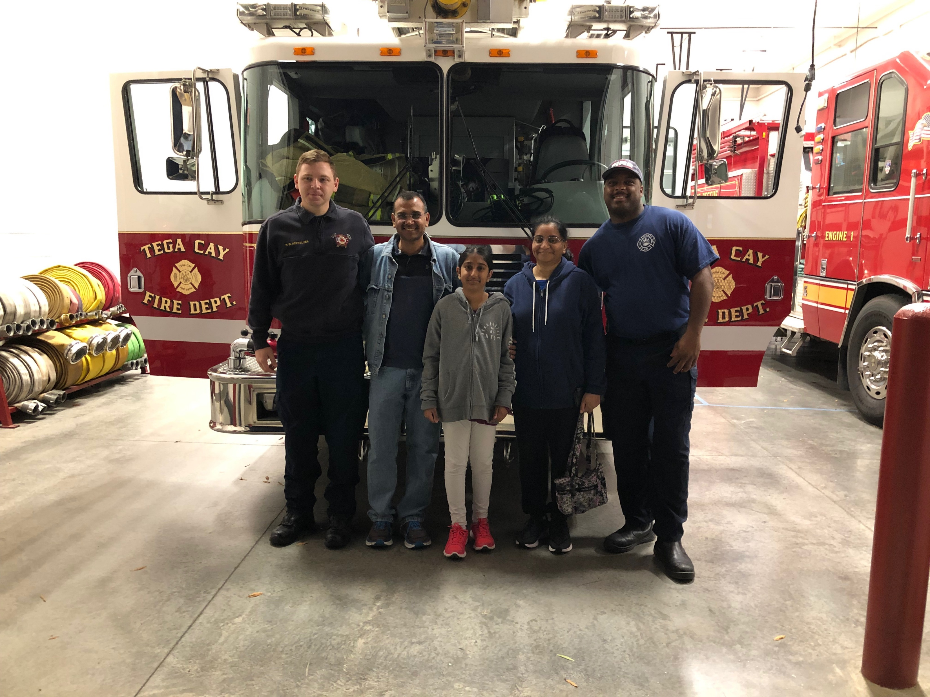
Community Involvement
City Events
  July 4th
  Fall Festival
  Veteran’s Day
  Camp Cadet
  Shop with a Hero
  National Night Out
Fire Department
  Read A Thon
  Ride to School with a Firefighter
  Story Time
  Open House
  Santa in the Cay
  9/11 Remembrance
  Lion’s Vision Screening

Slide 10
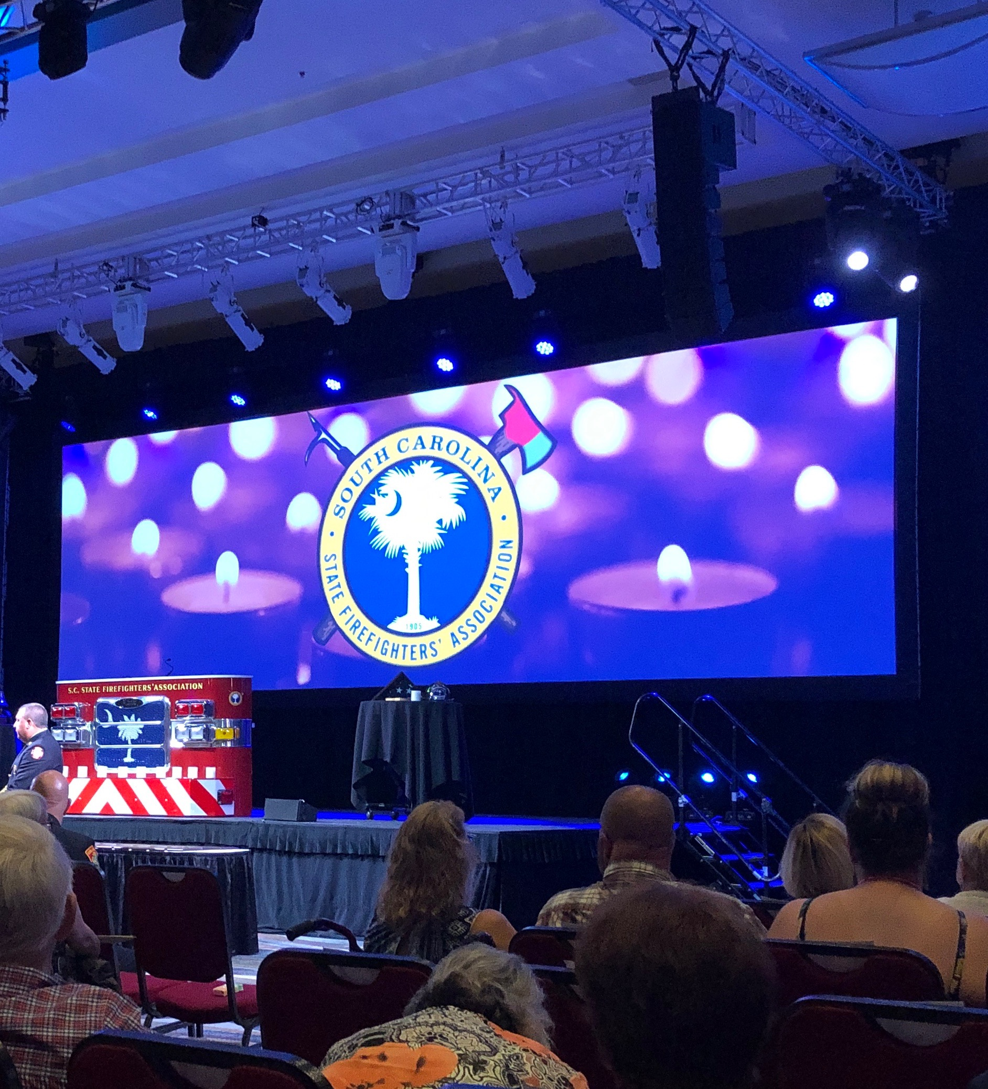
Partnerships
City
  Admin
  Utilities
  Public Works
  Police Department
  IT
  HR
  Operations
  Development Services
York County
  Fire Service
    Tanker Task Force
    Water Events
    Training
    Chief’s Association
  EMS
    Piedmont
    Fort Mill Rescue
  Carolina Dive and Rescue
Emergency Management
  Incident Action Planning
  Active Violence/MCI Task Force
  Weather and Natural Disaster Planning
  SC Mobilization
SC State
  ISO
  DHEC
  DNR
  SLED
  State Fire
  SC Fire Chief’s Association
National
  NFPA
  International Code Council - Inspections

