Slide 1
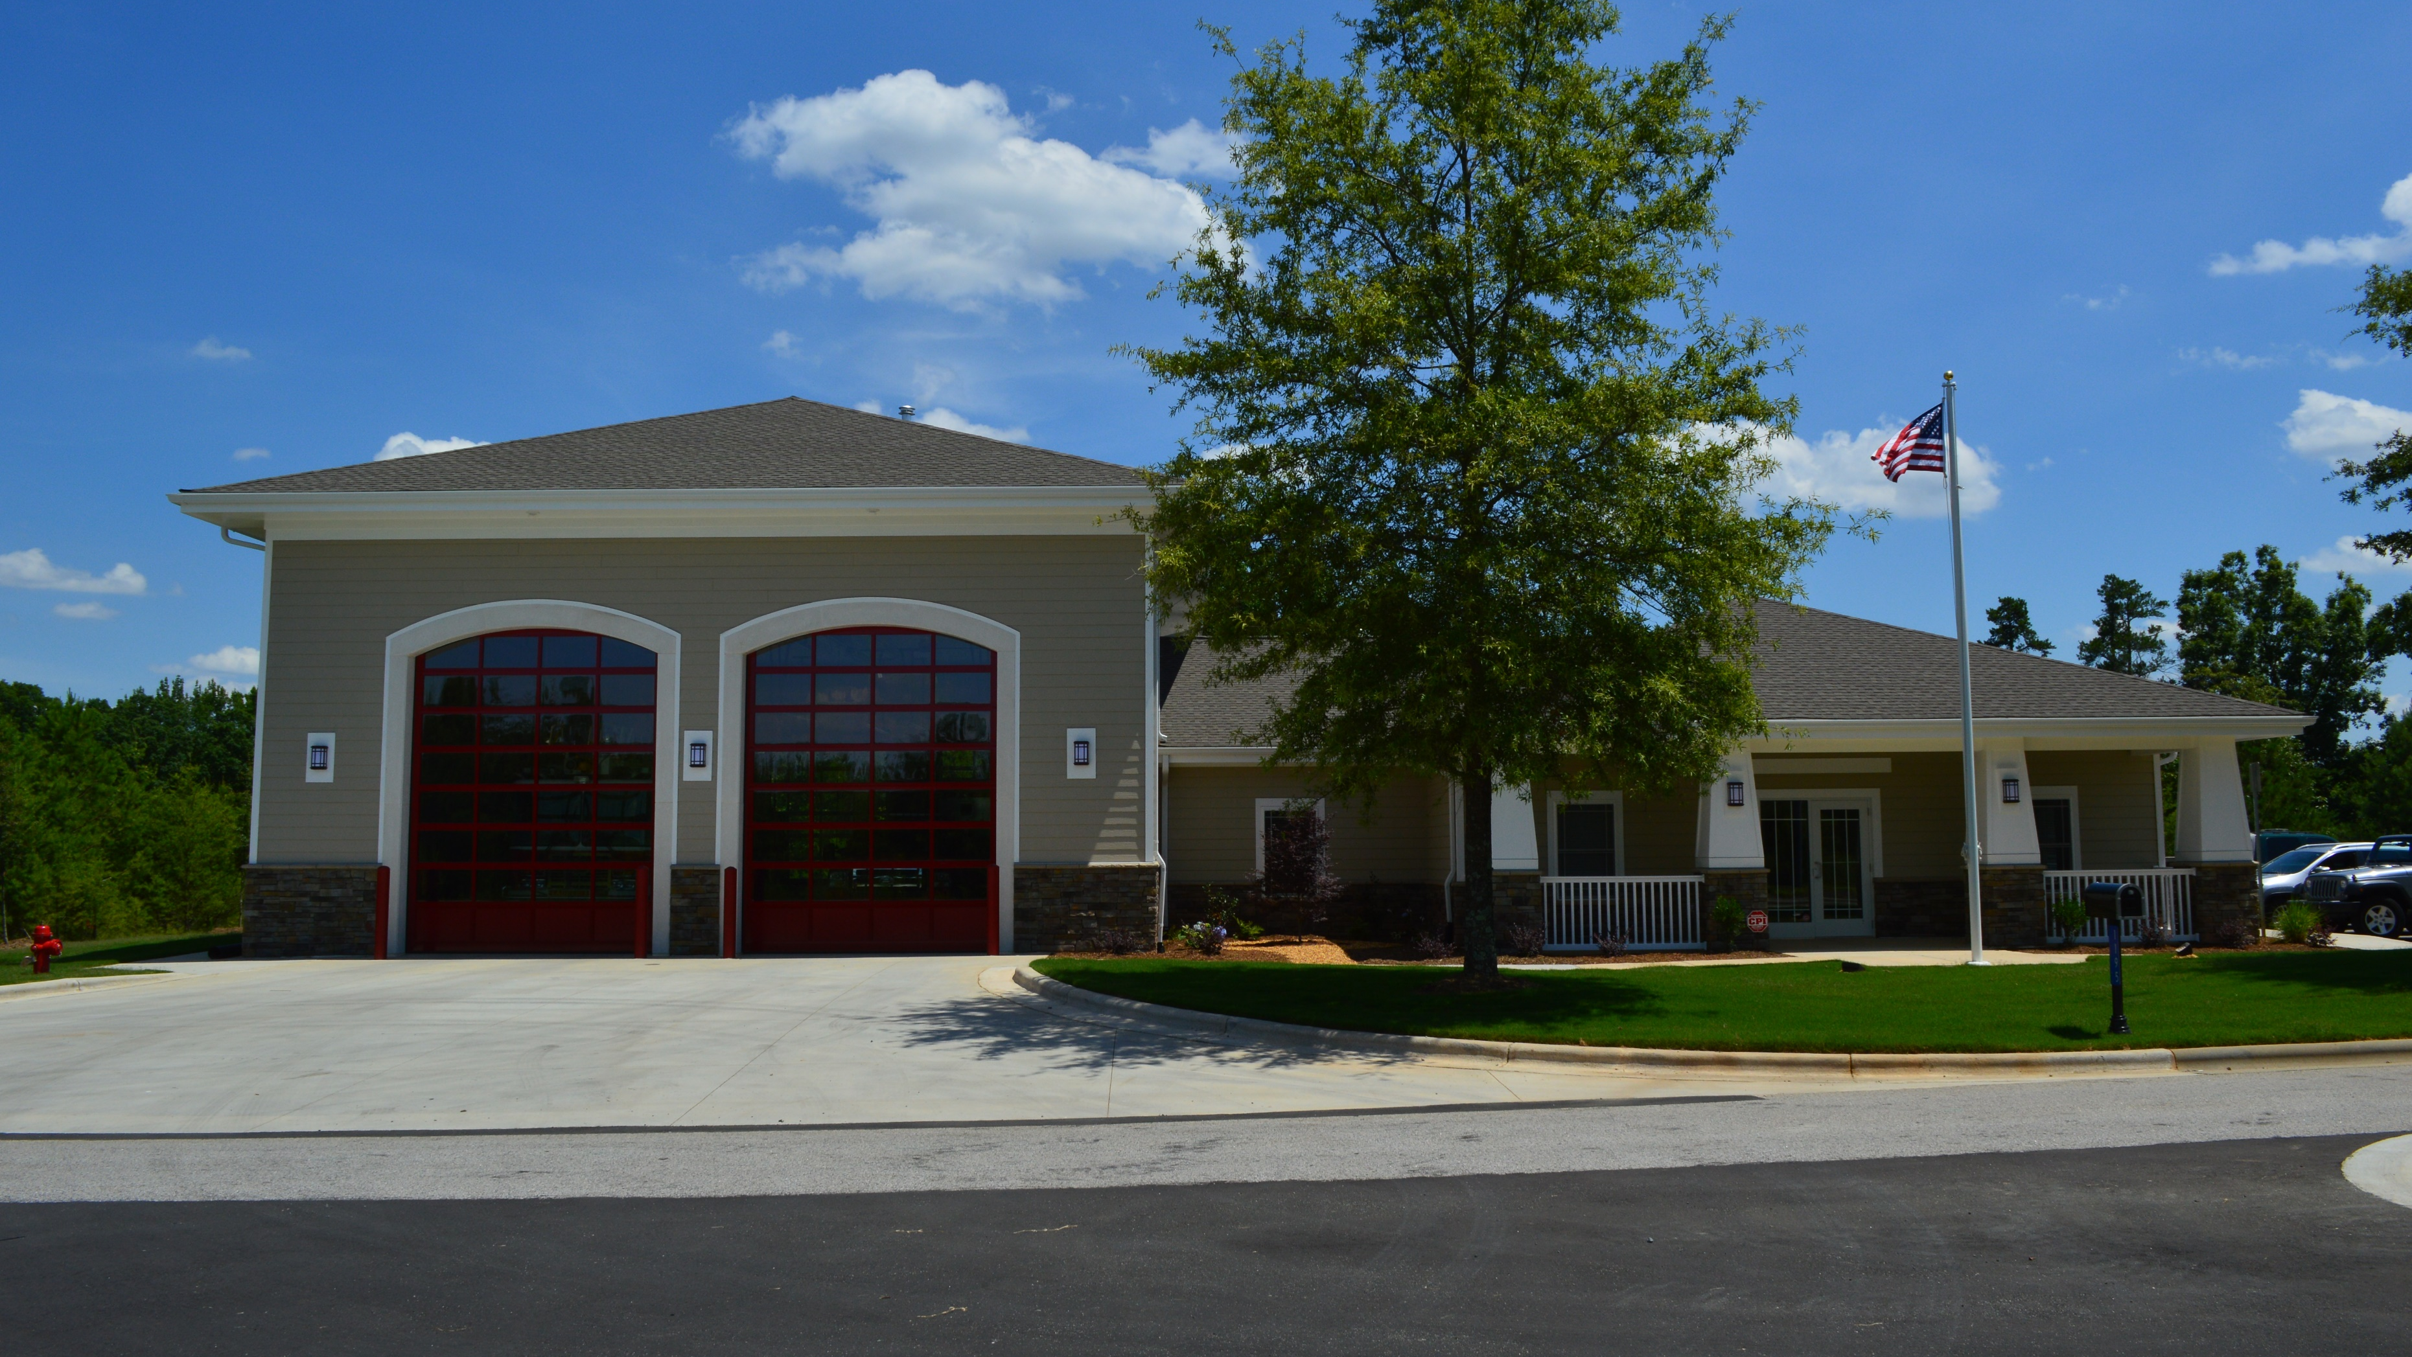

Tega Cay Fire Dept.
2020 Year End Review

Slide 2
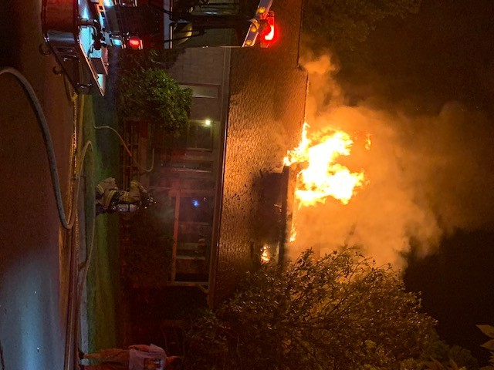
Response Stats
False Alarms | 93
Fire | 31
Good Intent | 138
Hazardous Condition | 25
Overpressure | 0
Rescue, EMS | 267
Service Call | 75
Special Event | 5
Weather Related Event | 7
YTD | 641

Slide 3
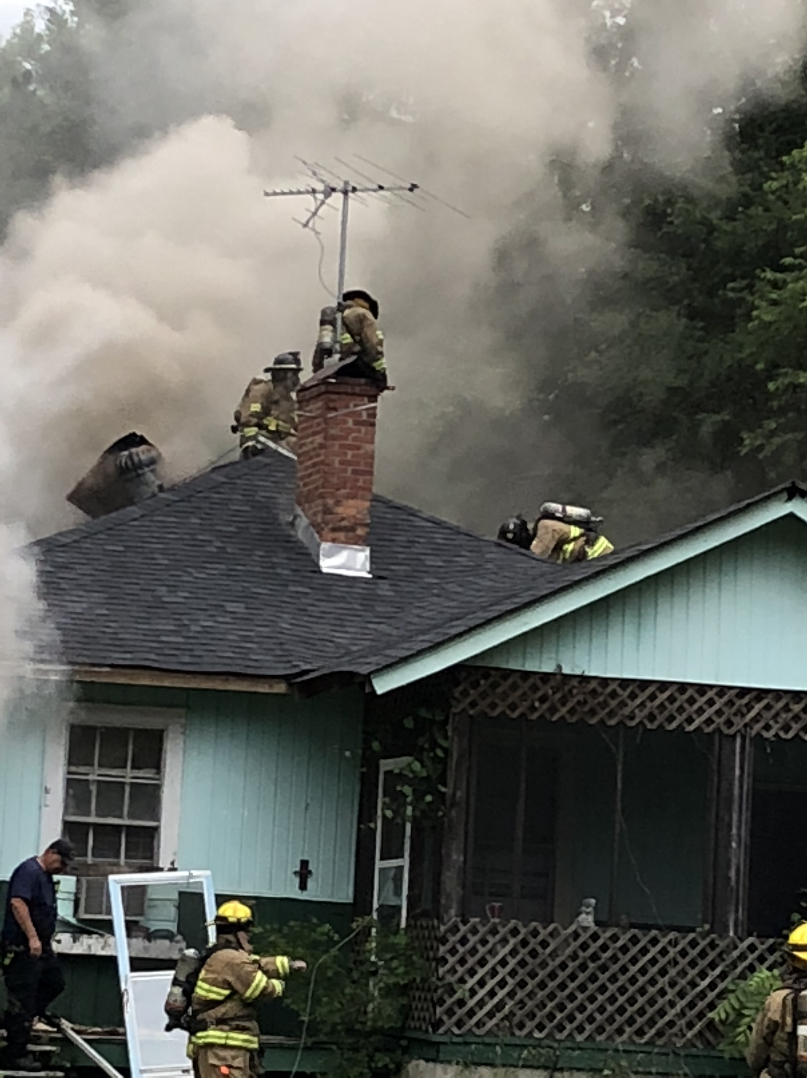
Training
Current Year Stats
  In 2020 the Tega Cay FD is on track to record over 3,000 training hours
Projections for FY2021
  High Angle 16 Hours
  Water Rescue Training 16
  ISO Compliant Class 1 Hours:
  EMT 24 Hours

Slide 4
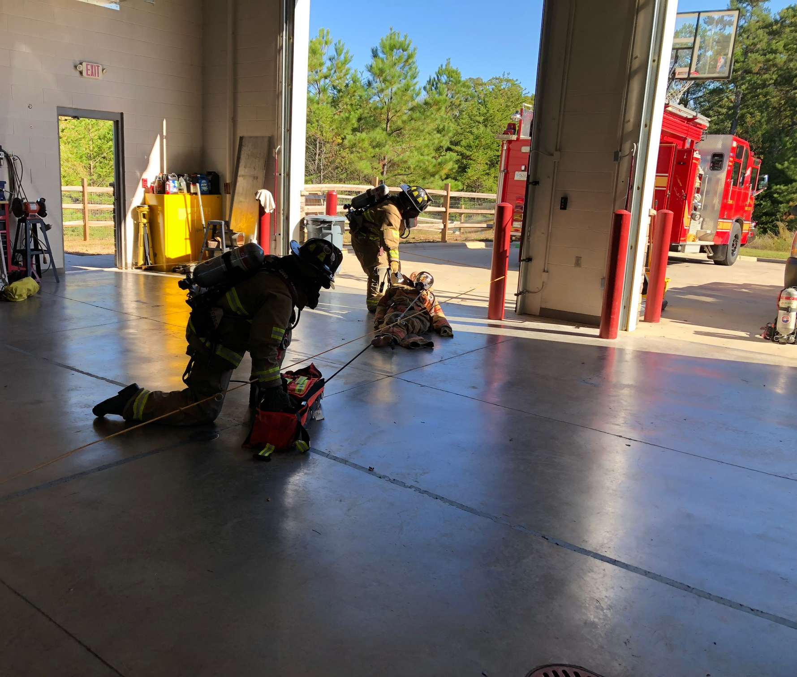
Initiatives
Events
EMS
Response
Education
IAPs
Community Involvement
Training

Slide 5
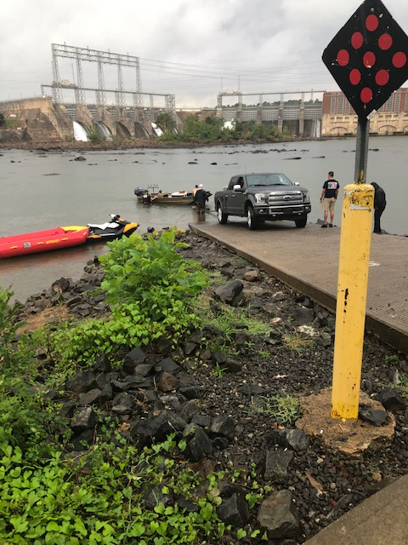
Initiatives
ESO Software
  Preplan and Inspection Program
  Fire and Medical Records Management
Informational Platform Development
  Operations and Administration
  COVID Staffing Impacts
Mobile CAD
Fire House Subs Public Safety Foundation Grant

Slide 6
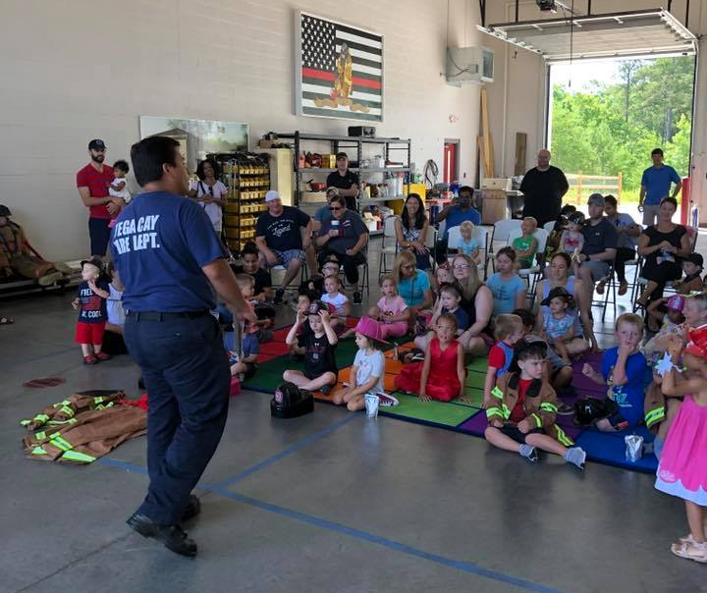
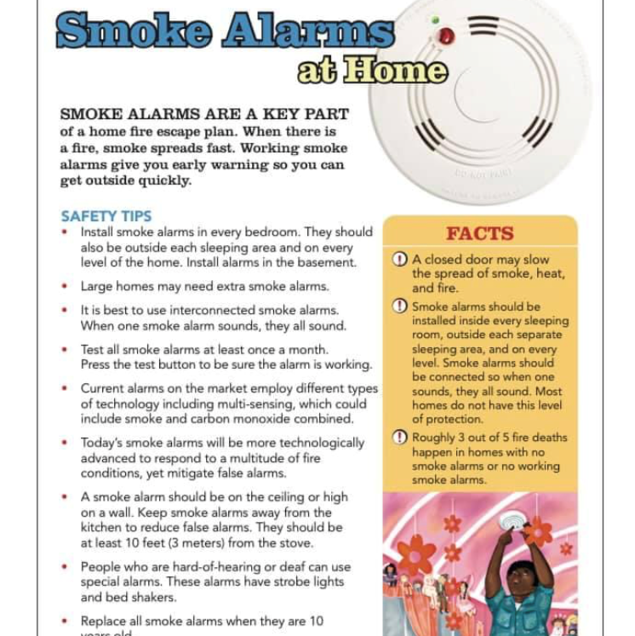
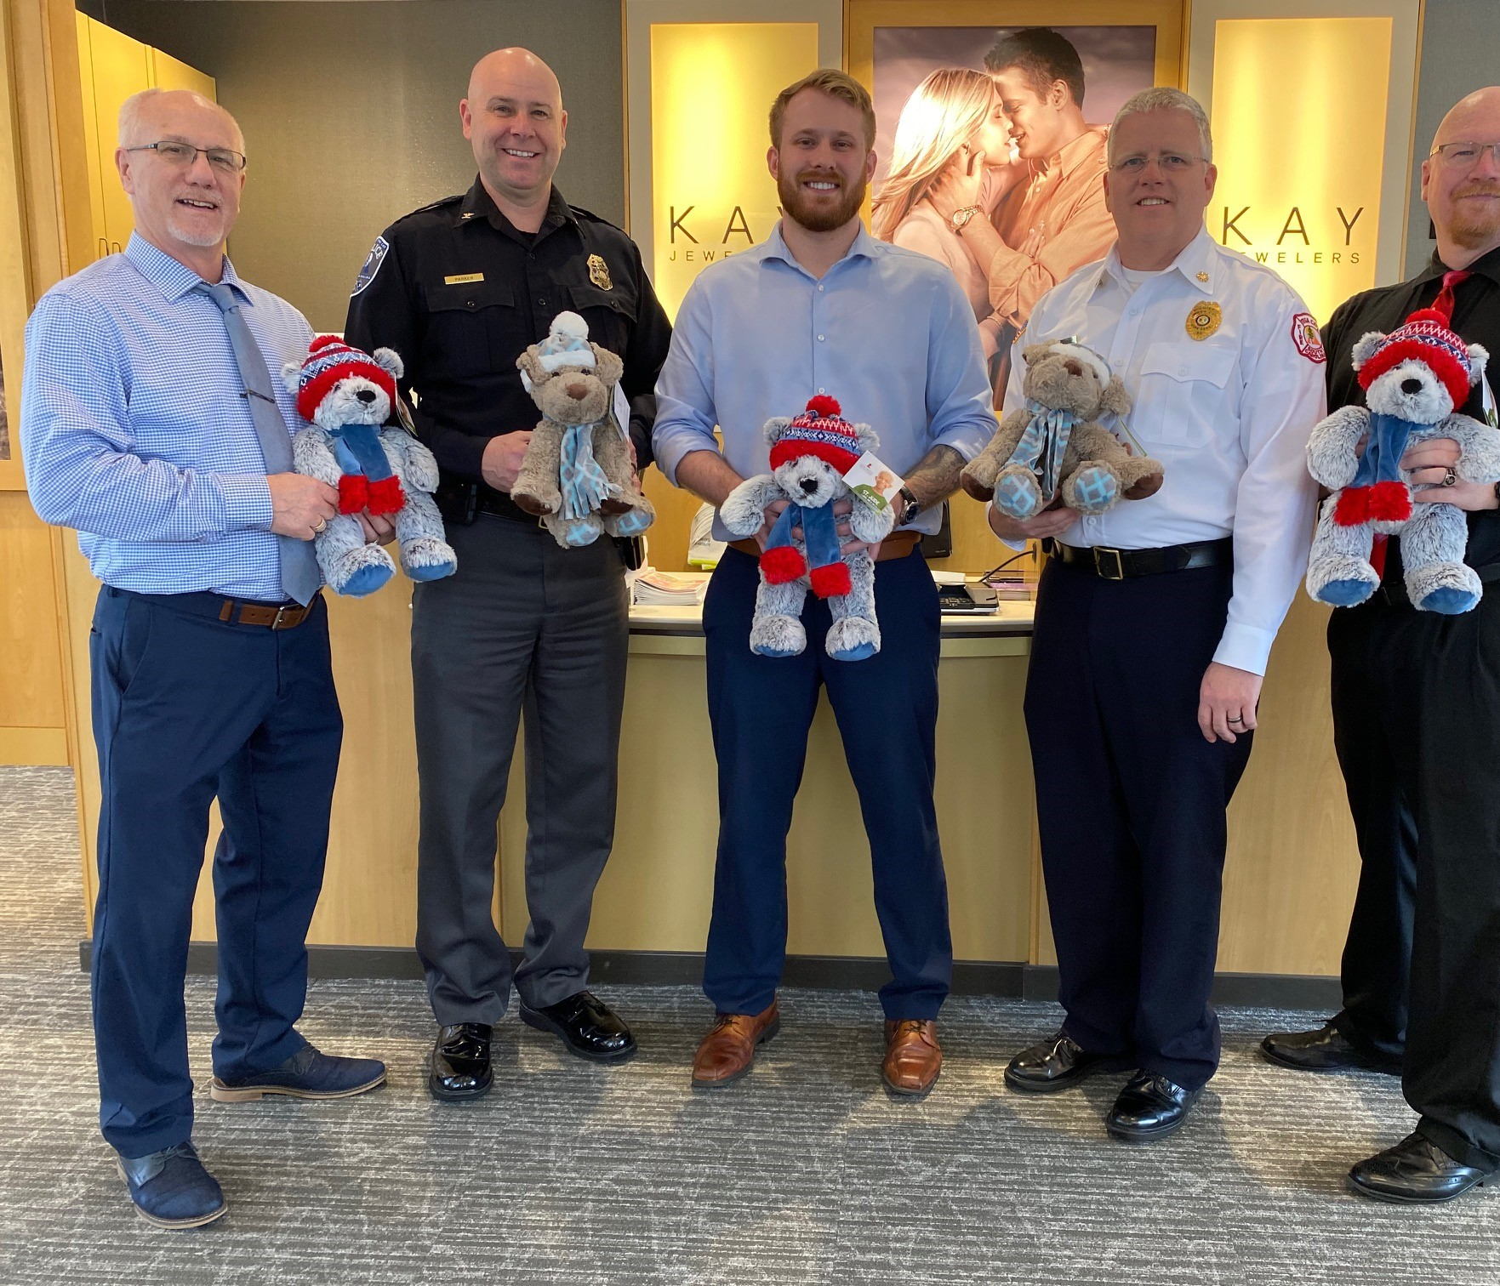

Education
COVID Impacts
  Fire Safety Videos
  58000 views on Social Media Up From 1400 Safety Messaging
  Fitness Friday’s
Read, Interact & Educate

Slide 7
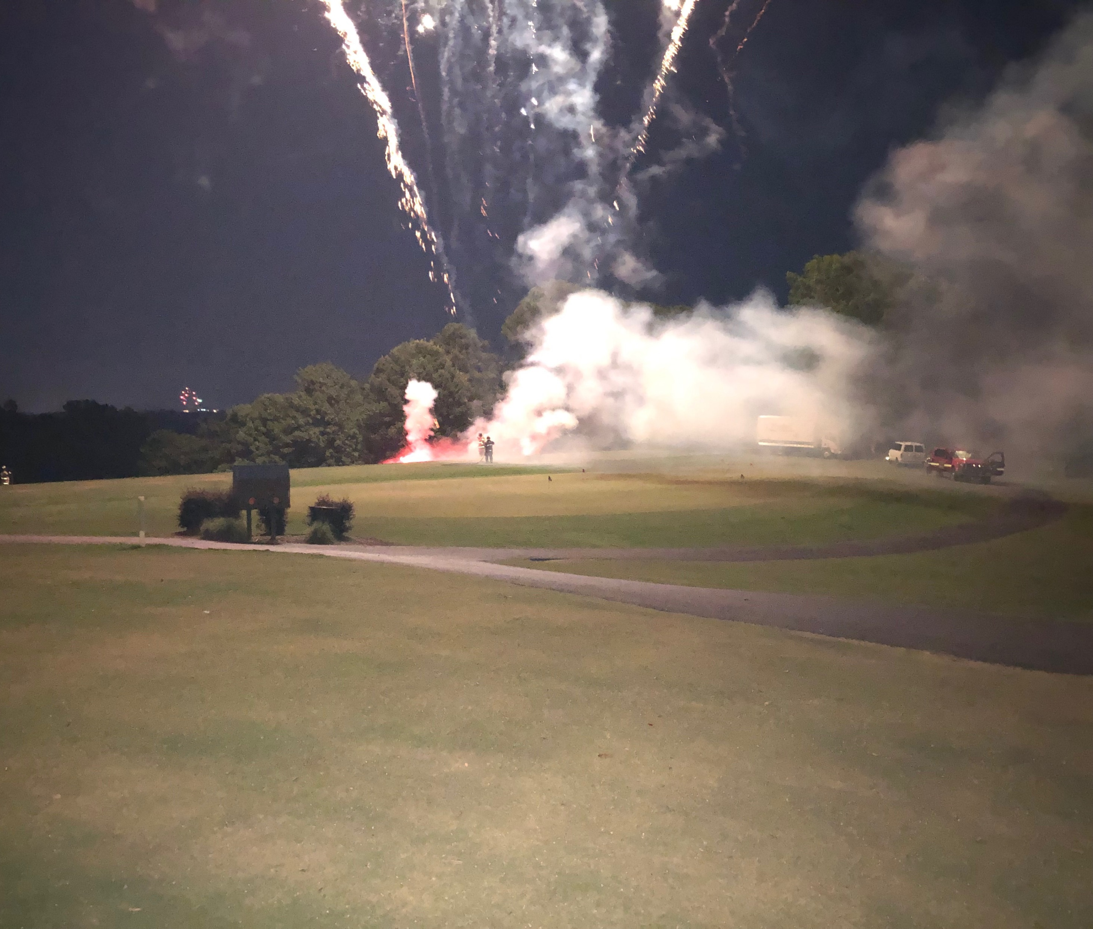
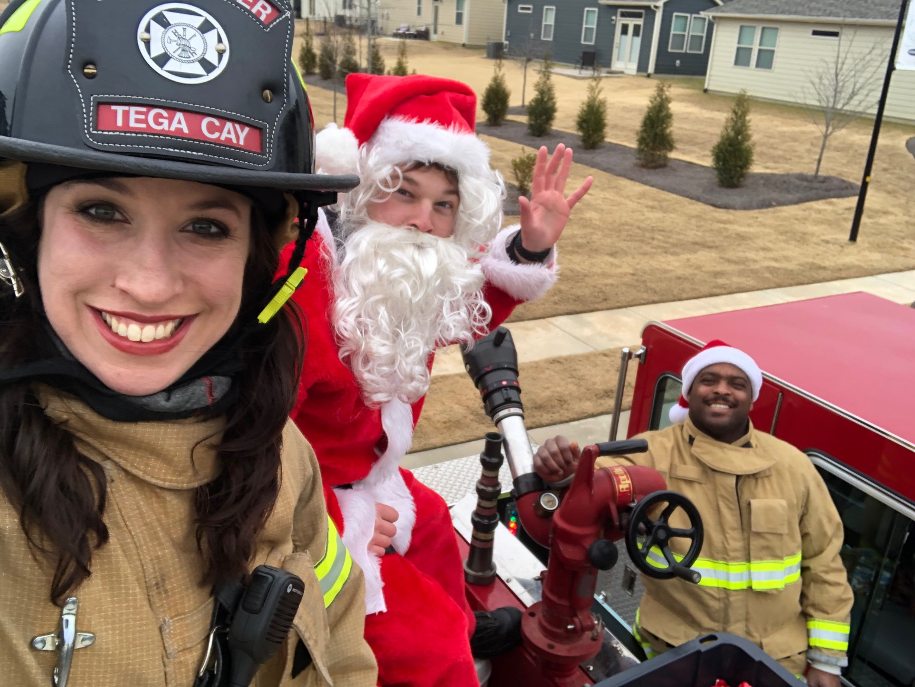
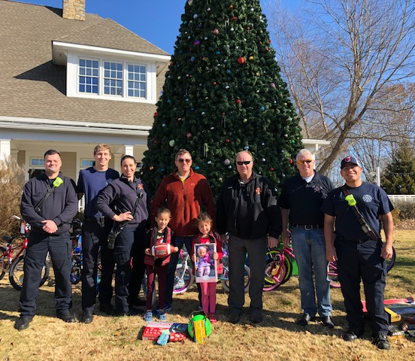
Community Involvement
City Events
  July 4th
  Veteran’s Day
  Shop with a Hero
Fire Department
  Ride to School with a Firefighter
  Virtual Story Time/Open House
  9-11 Remembrance
  Santa in the Cay

Slide 8
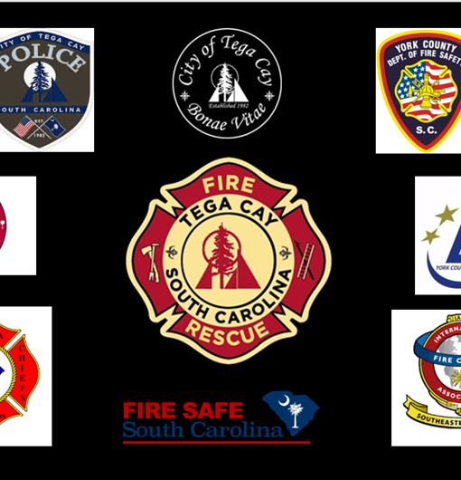
Partnerships
City Departments
County Agencies
  Piedmont EMS
York County Fire Service
Emergency Management
SC State Agencies
  CRR – Fire Safe City
National and International
  International Assn. of Fire Chief’s
  International Code Council
  National Fire Protection Agency

