Slide 1
Tega Cay Fire Department
FY 2023 Annual Report

Slide 2


TCFD Team
Staffing
29 Operationally Certified Firefighters
23 Full Time Paid Firefighters
6 Volunteer Firefighters
14 Support/Lifetime Members
1 Administrative Assistant | Part Time Fire Marshal
1 Vacant Position

Slide 3
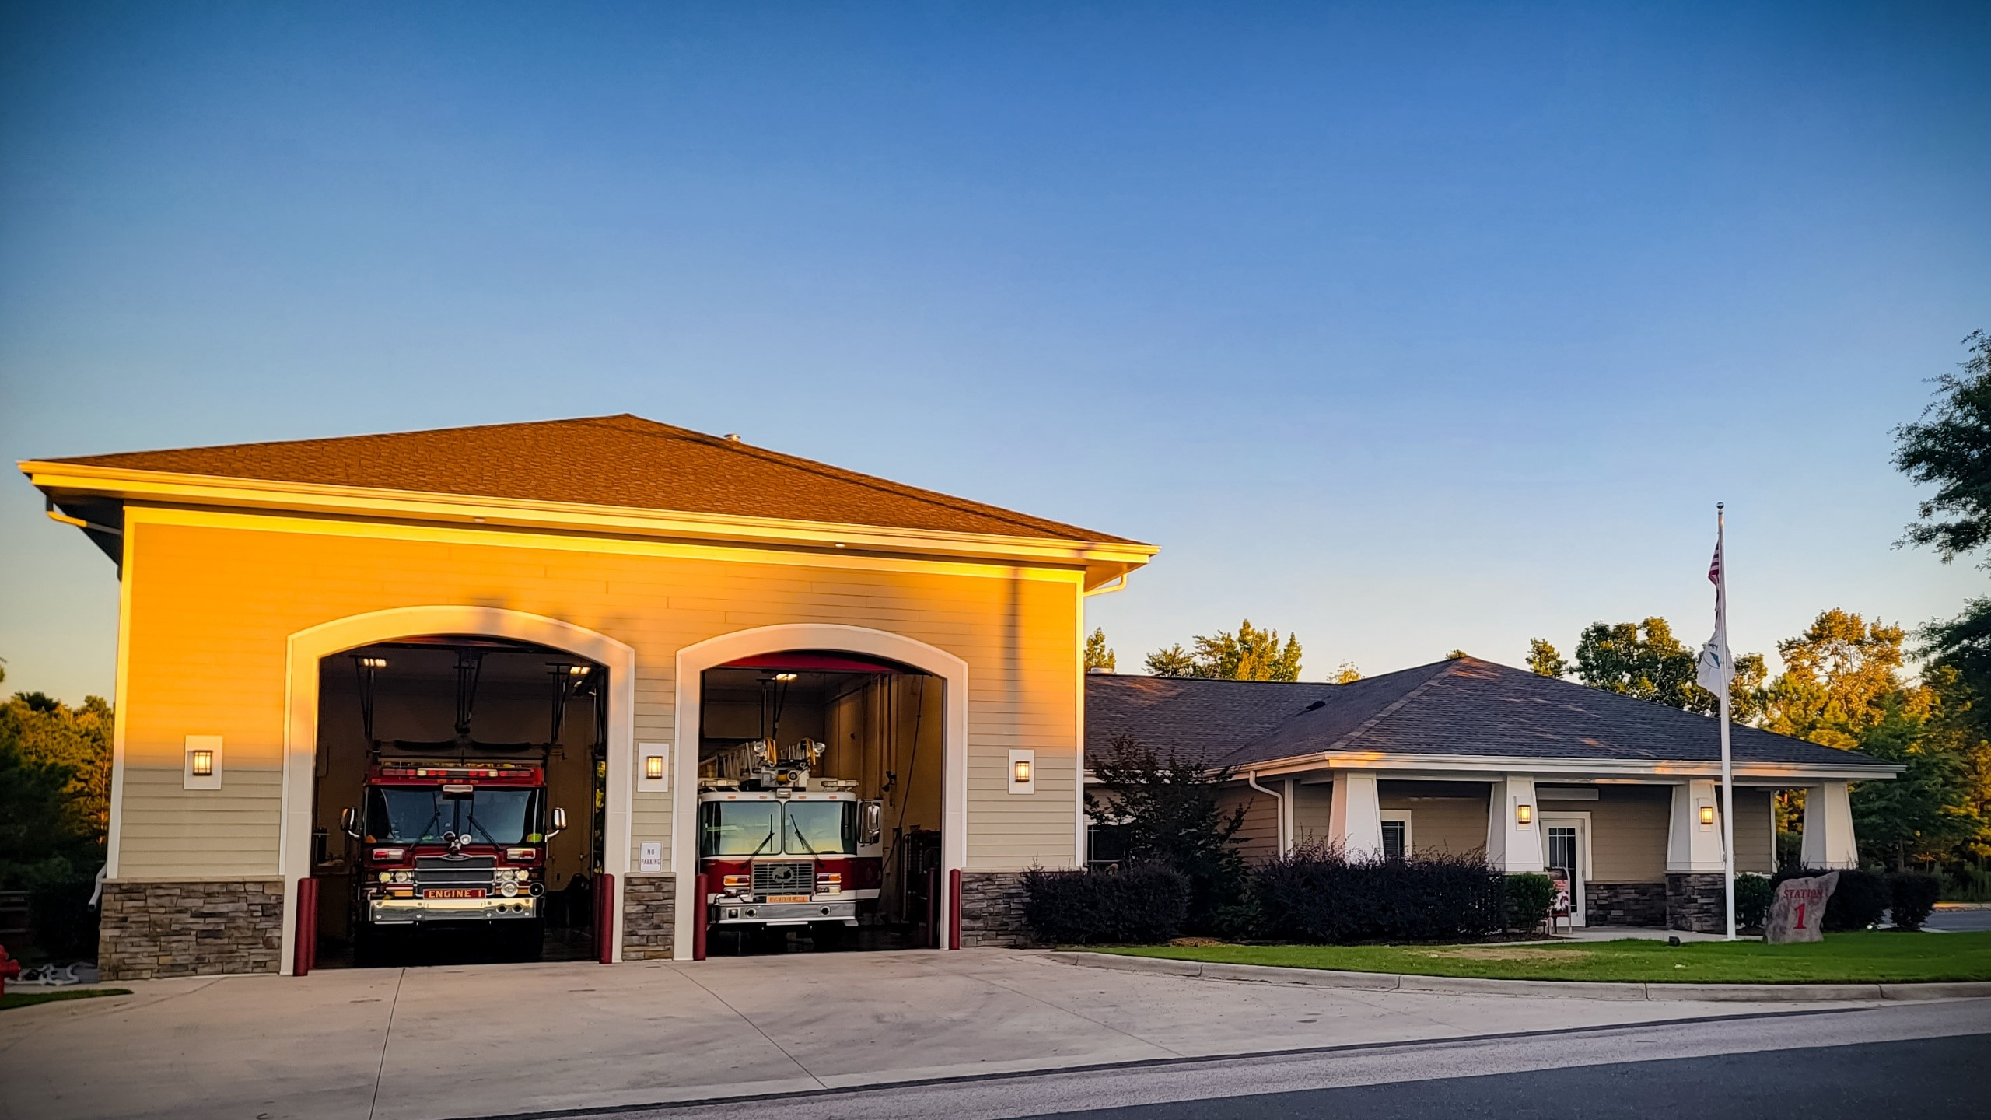
TCFD Facilities
Station 1
Headquarters
Administrative Staff
Ladder 1
Engine 1
Brush 1
Ski 1

Slide 4
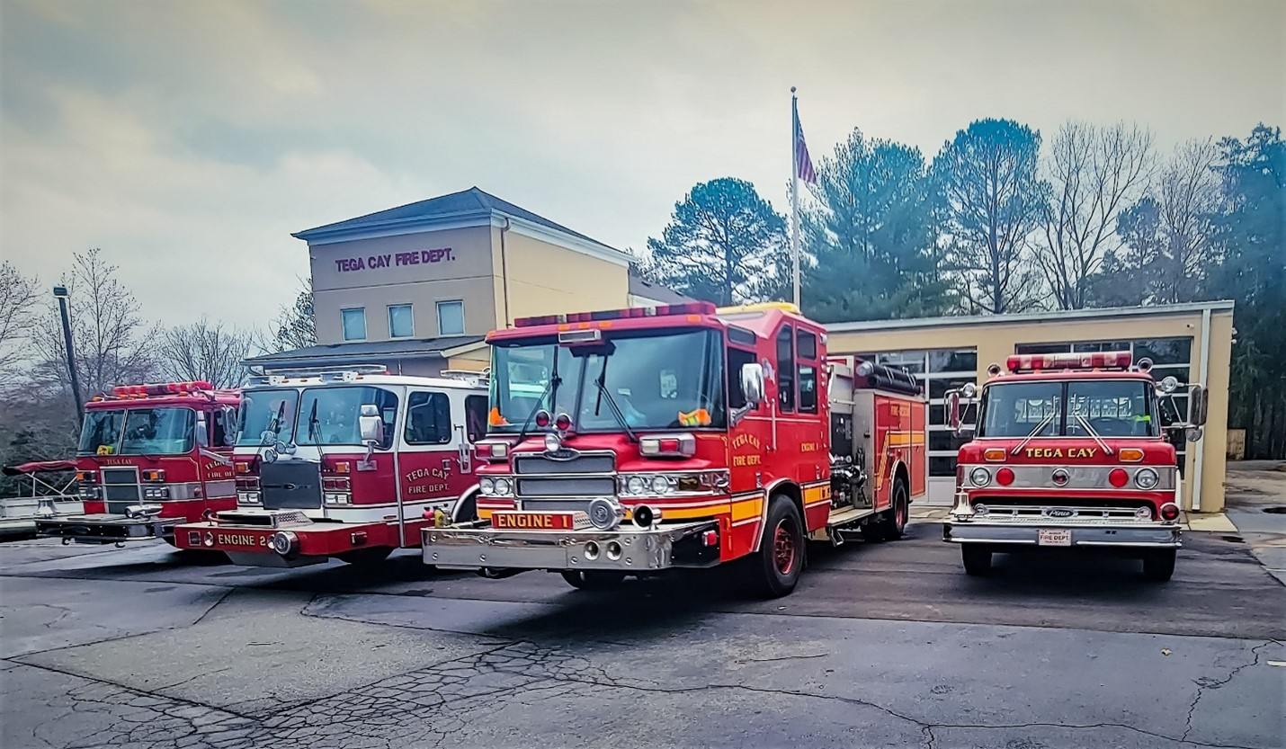
Station 2
Peninsula Station
Engine 2
Pumper Tanker 4
Service 1
Marine 2

Slide 5

2023 Fire Incident Data
Fire Incident Type Breakdown (YTD as of 12/5/23)
Incident Type Group
Number of Incidences
100 - Fire
37
200 - Series
2
300 - EMT
582
400 - HAZMAT
30
500 - Service Call
75
600 - Series
227
700 - False Alarm
155
800 - Natural Disaster
1
900 - Special Incident
1
TCFD est. calls to 12-31-23
100
1210

Slide 6
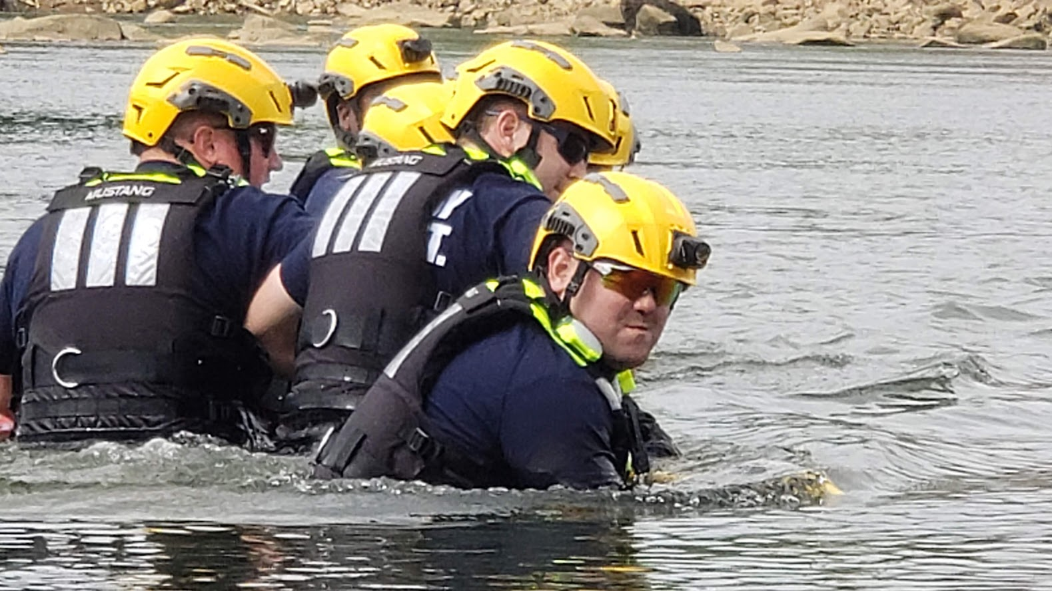
Organizational Functions
Fire and EMS Management
Response
Prevention
Plans Review
Inspections
Enforcement
Pre-Incident Planning
Operations and Administration

Slide 7
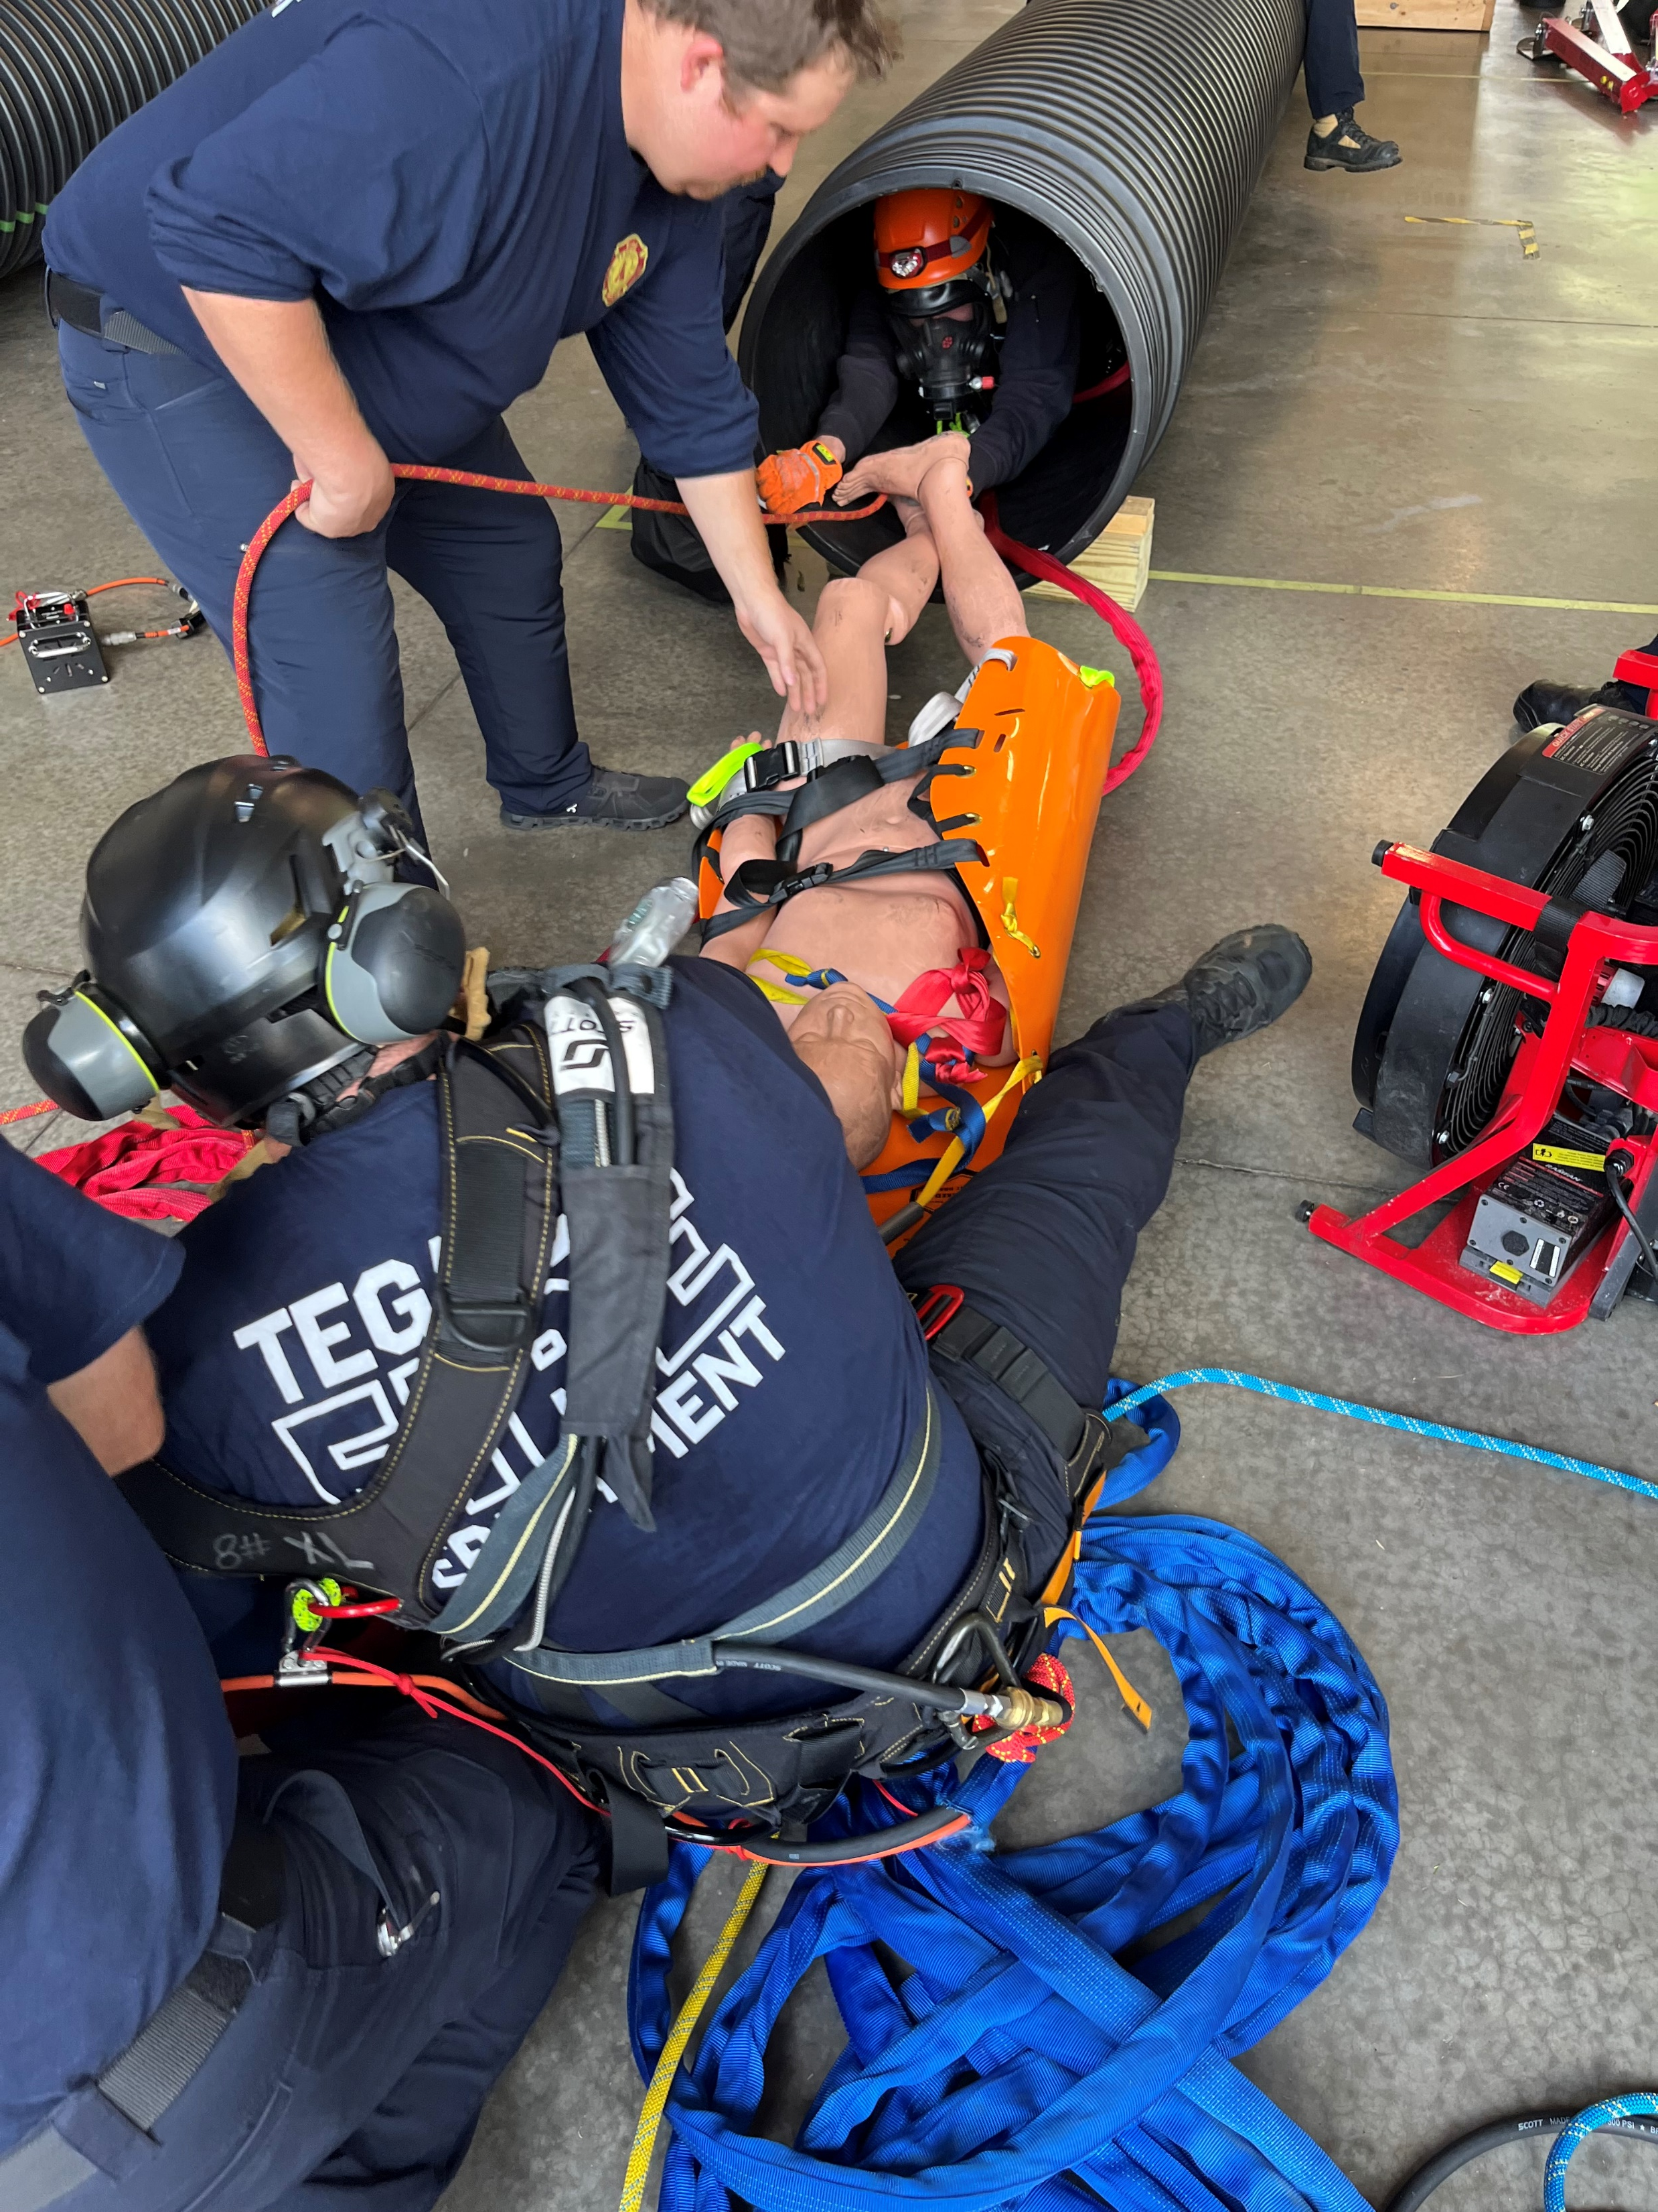
Initiatives
Community Risk Reduction
Incident Action Planning
Emergency Management
Events
Grants
Duke Energy
Elks Lodge
Municipal Association of S.C.

Slide 8
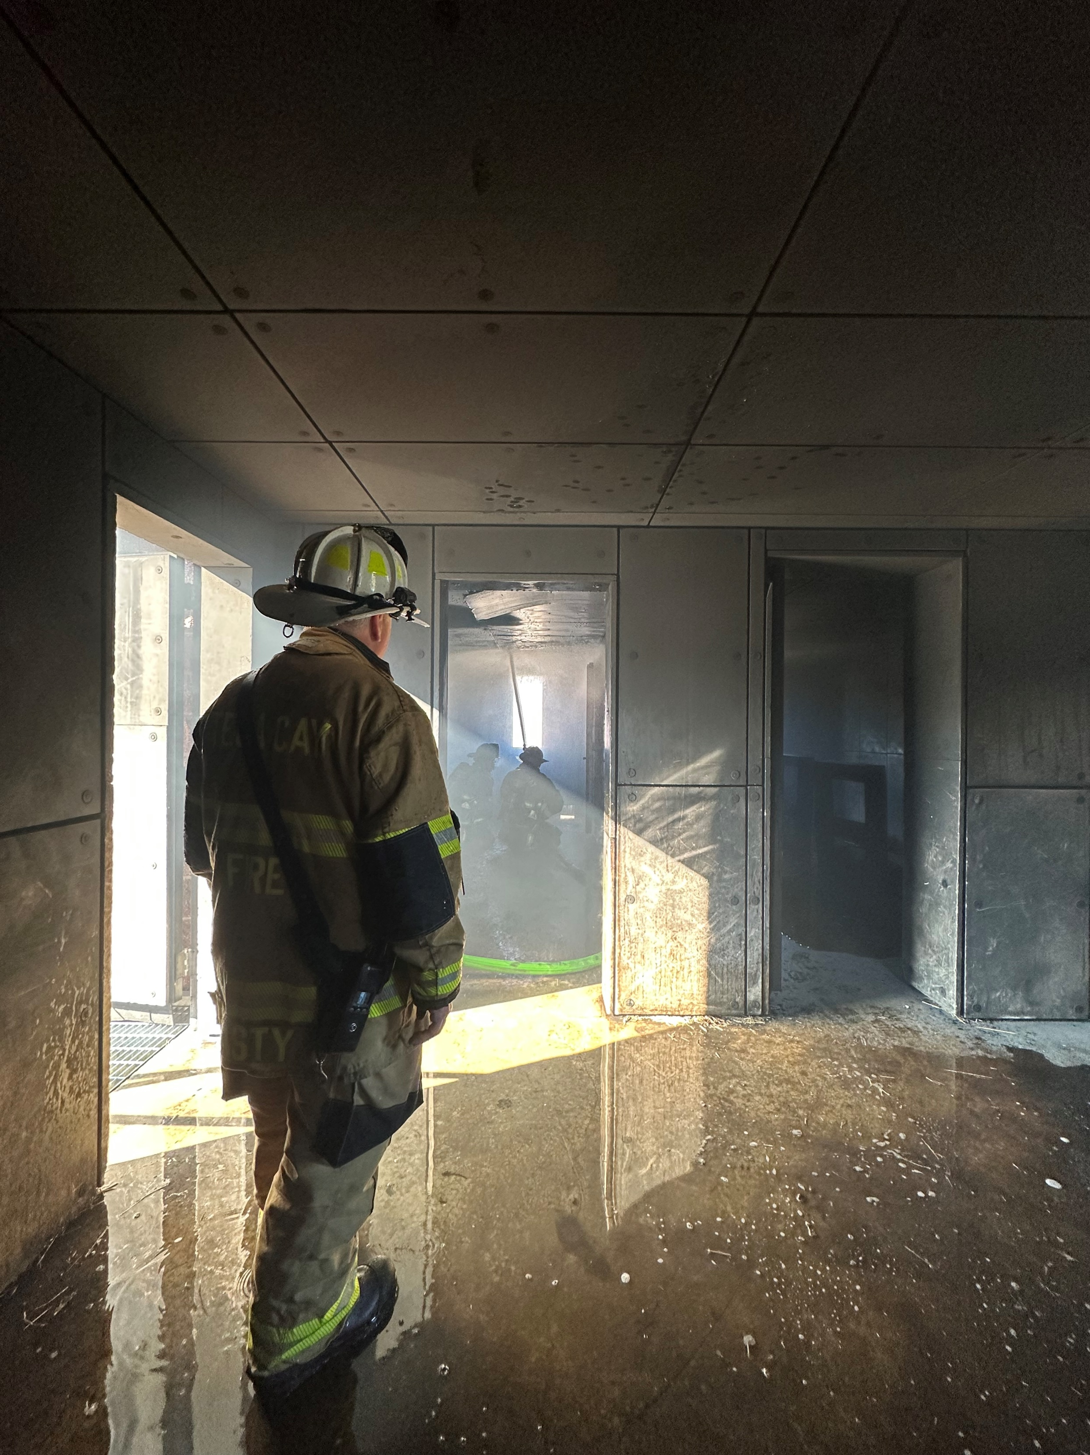
Training
2023 Stats
Over 5000 departmental training hours.
Projections for 2024 include:
Fire Classes
Water Operations both Flat and Swiftwater
EMT with Focus on Drug Administration
Technical Rope and Confined Space Rescue
Vehicle Extrication and Stabilization

Slide 9
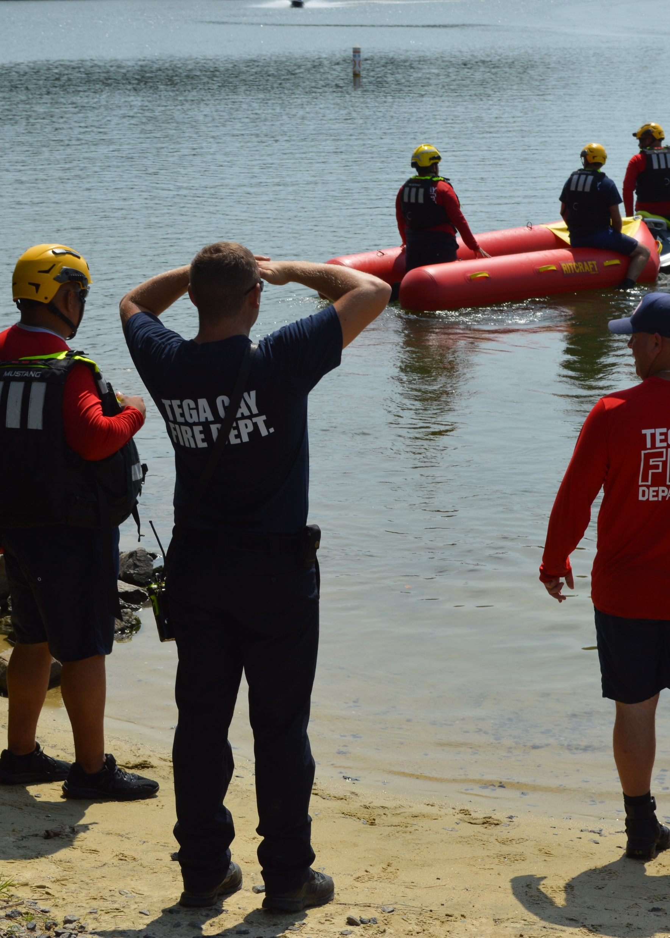
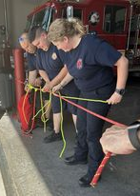
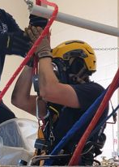
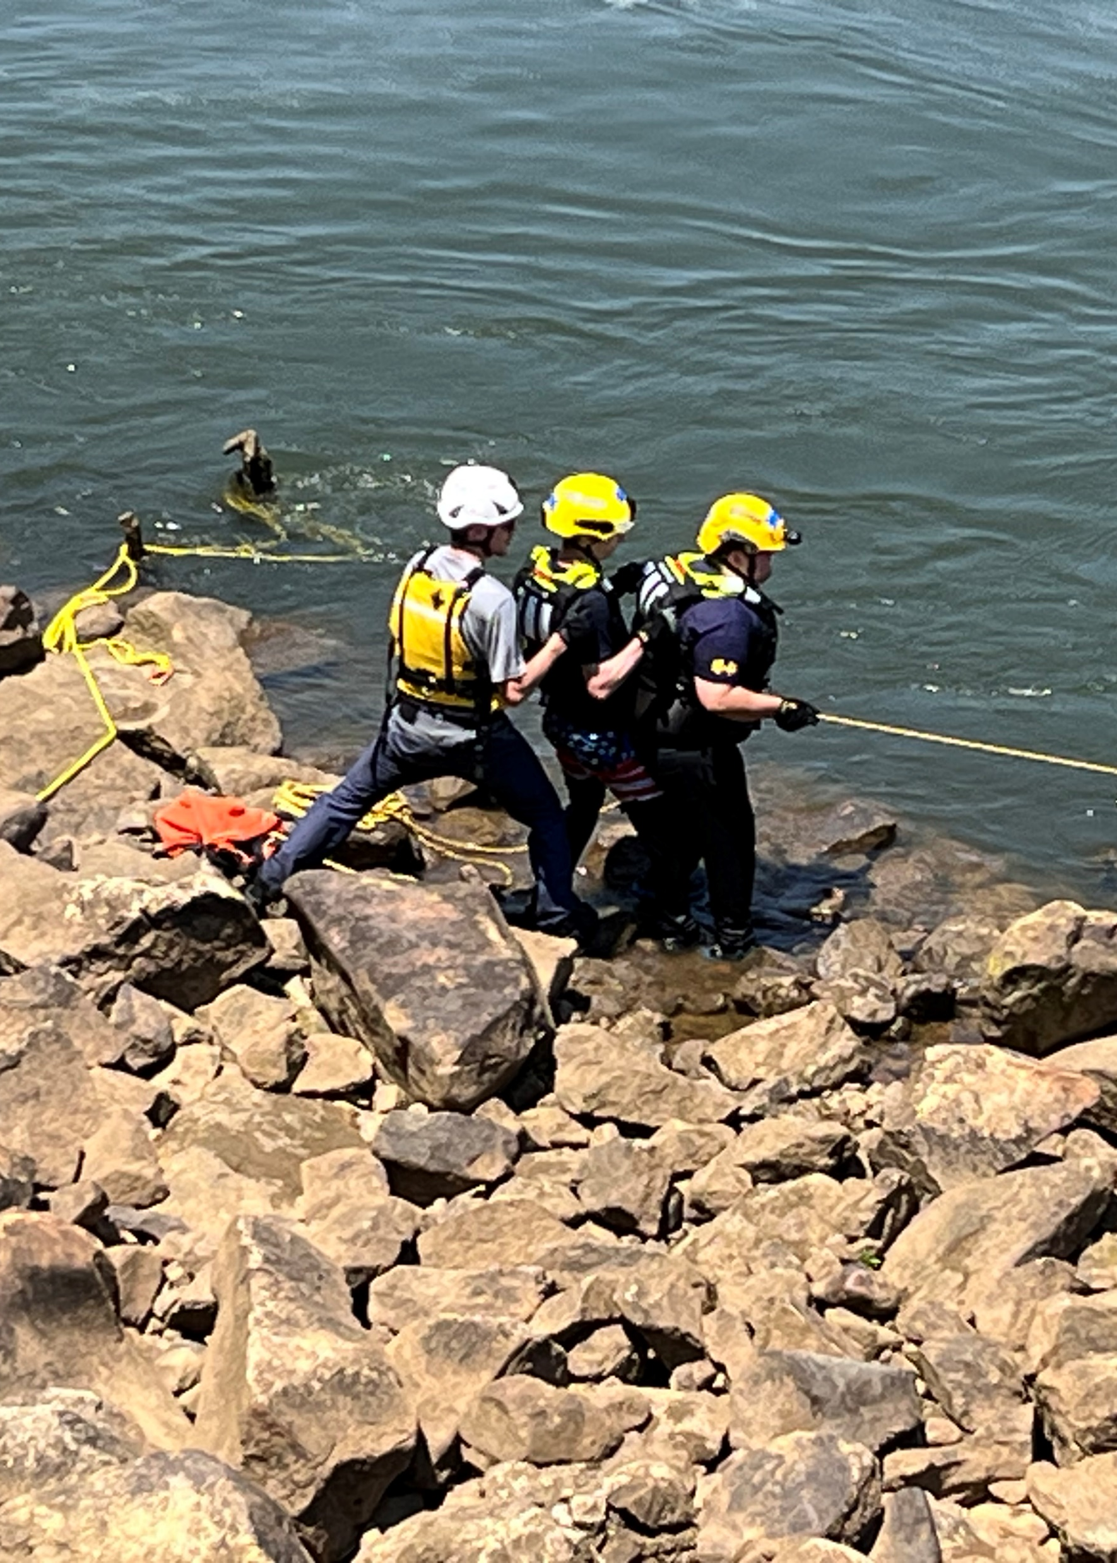
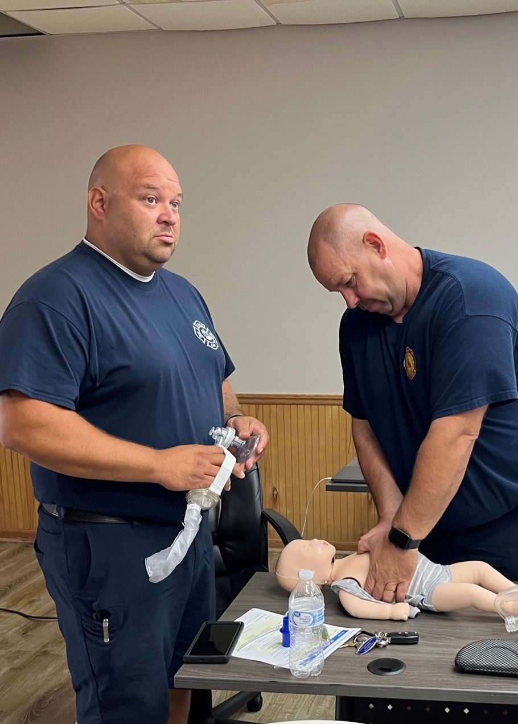
Departmental Training

Slide 10
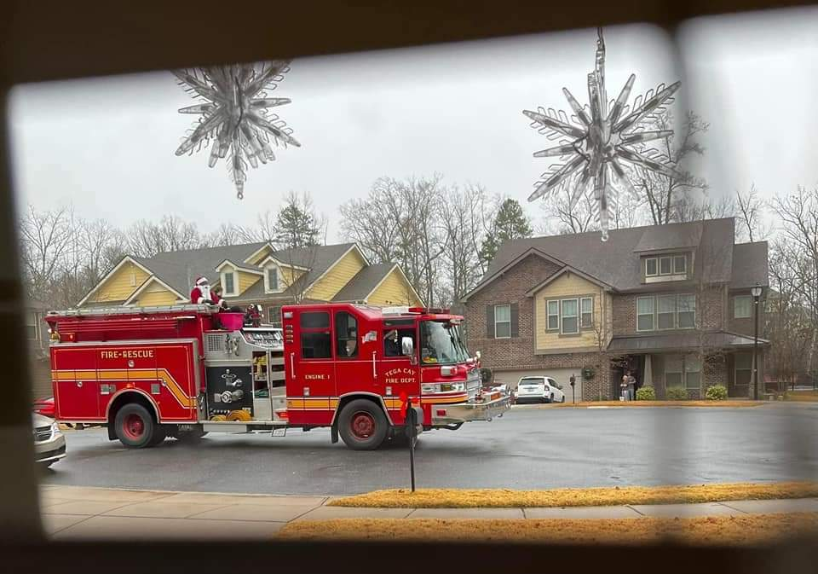
Community Involvement
Community Risk Reduction – Fire Safe City
Fire Safety Messaging
Social Media Views
Fire Safety Mailer
Fire Safety Presentations
Schools
Civic Groups
Public Safety Meetings
In Home Fire Safety
Fire Prevention Week Open House

Slide 11
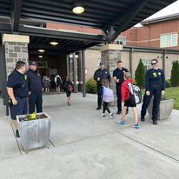
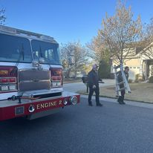
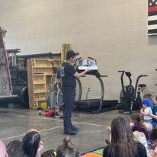
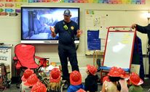
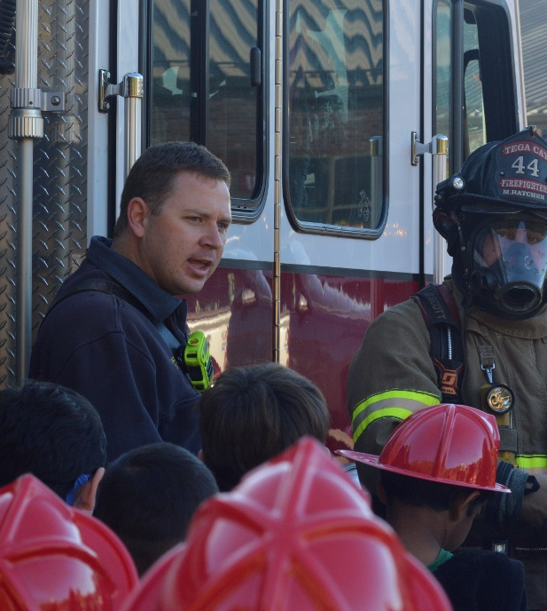
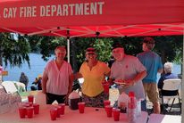
Community Involvement

Slide 12
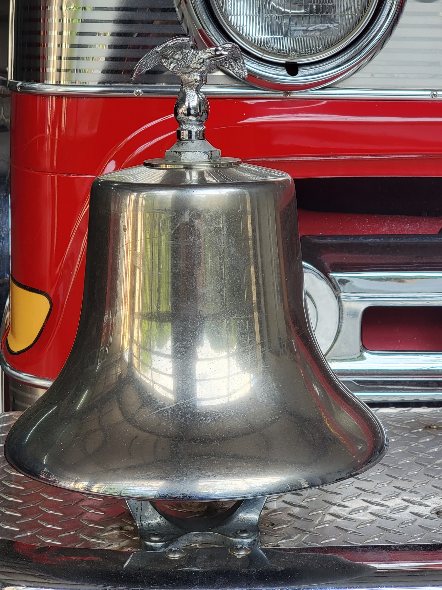
Partnerships
City Departments
County Agencies
York County Fire Service
Emergency Management
SC State Agencies
SC State Fire Academy
Fire Safe SC
SC Fire Chief’s Association
National and International
International Association of Fire Chiefs
International Code Council
National Fire Protection Association

Slide 13
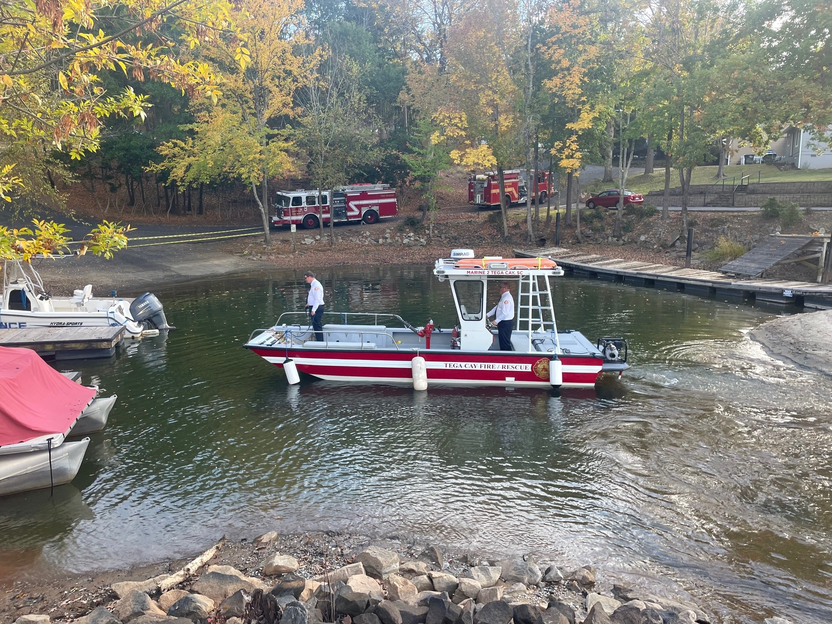
2023 – 2024 Projections
Staff Development Focus
Officer Training
Working with at risk populations
Technical Rescue Training
Active Violence Training
Technology Enhancements
ISO Class 1 Fire Training
Smoke Alarm Blitz
EMT Service Enhancement
Facility Enhancement

