Slide 1
Tega Cay Fire Department
  FY 2022 Annual Report

Slide 2

Our Department
Staffing
29 Operationally Certified Firefighters
  23 Staff
  6 Volunteer Firefighters
14 Support Members
1 Administrative Assistant
1 Part Time Fire Marshal
2 Vacant Positions

Slide 3
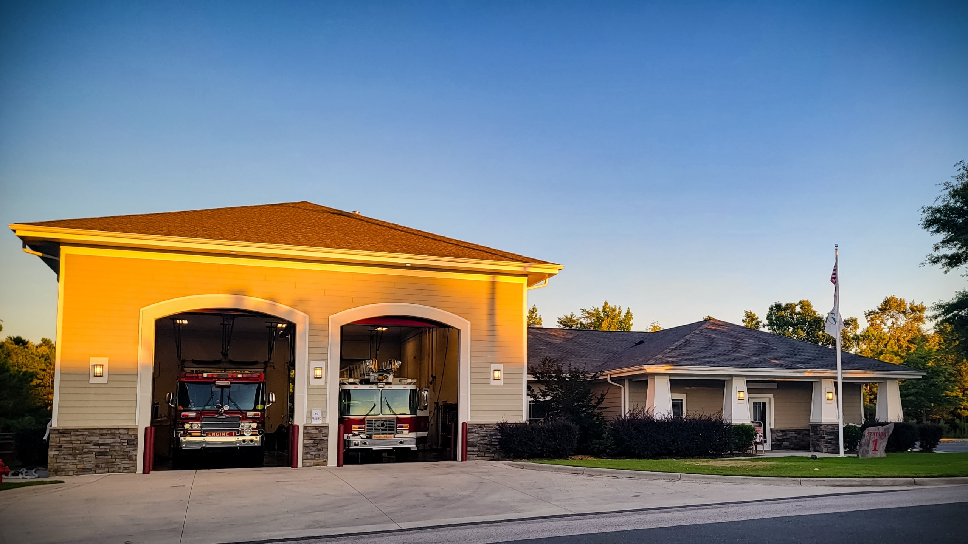
Our Department
Station 1
Headquarters Station
Administrative Staff
Ladder 1
Engine 1
Brush 1
Ski 1

Slide 4
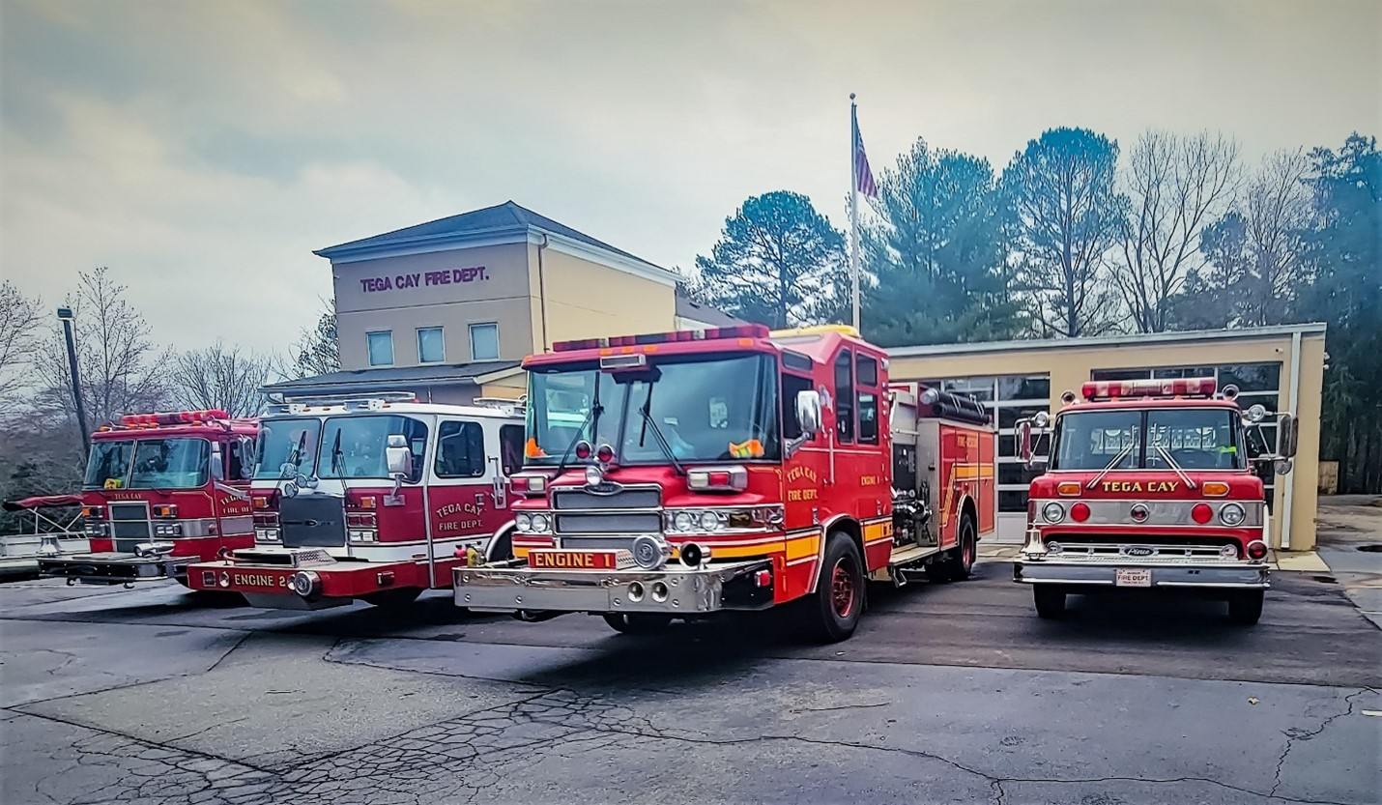
Our Department
Station 2
Peninsula Station
Engine 2
Pumper Tanker 4
Service 1
Marine 2

Slide 5
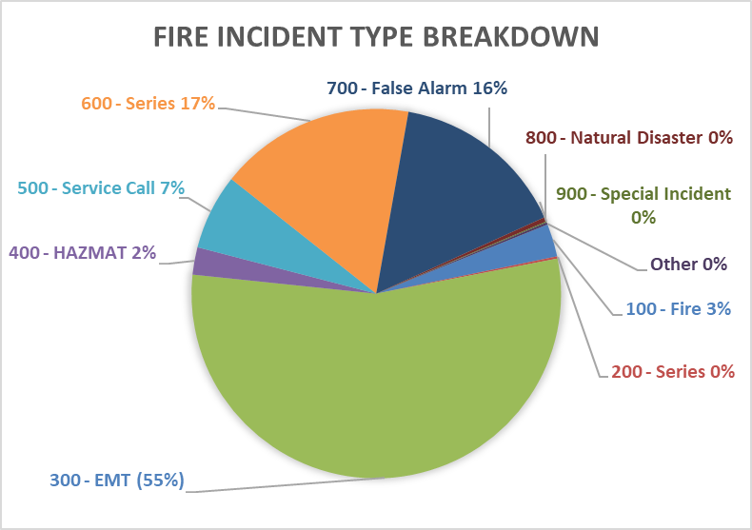
2022 Fire Incident Data

Slide 6
Initiatives
Fire and EMS Management
Response
Prevention
Plans Review
Inspections
Enforcement
Pre-Incident Planning
Operations and Administration

Slide 7
Initiatives
Community Risk Reduction
Incident Action Planning
Emergency Management
Events
Grants
    Duke Energy
    Fort Mill Elks
    SAFER
    Apprenticeship Carolina/ Dept. of Labor

Slide 8
Training
2022 Stats
In 2022 the Department reported in excess of 4000 departmental training hours.
Projections for 2023 include:
  Basic Fire Classes
  Swift Water Rescue
  Flat Water Rescue Training
  Boat Operations
  EMT with Focus on Drug Administration
  Technical Rope and Confined Space Rescue
  Vehicle Extrication and Stabilization

Slide 9
Community Involvement
Community Risk Reduction – Fire Safe City
Fire Safety Messaging
  85,547 Social Media Views
  Fire Safety Mailer
Fire Prevention Week Open House
Fire Safety Presentations
  Schools
  PTA/PTO’s
  HOA’s
  Civic Groups

Slide 10
Partnerships
City Departments
County Agencies
York County Fire Service
Emergency Management
SC State Agencies
  SC State Fire Academy
  Fire Safe SC
  SC Fire Chief’s Association
National and International
  International Association of Fire Chiefs
  International Code Council
  National Fire Protection Association

Slide 11
2022 – 2023 Initiatives
Technology Enhancement to Reduce Response Times
ISO Class 1 Fire Training
Technical Rescue Training and Increase in Capability
Active Violence Training w/TCPD and County Agencies
MCI Training
EMT Service Enhancement
Facility Enhancement
Public Safety Citizens Academy w/TCPD
Fire Alarm Blitz

