Slide 1

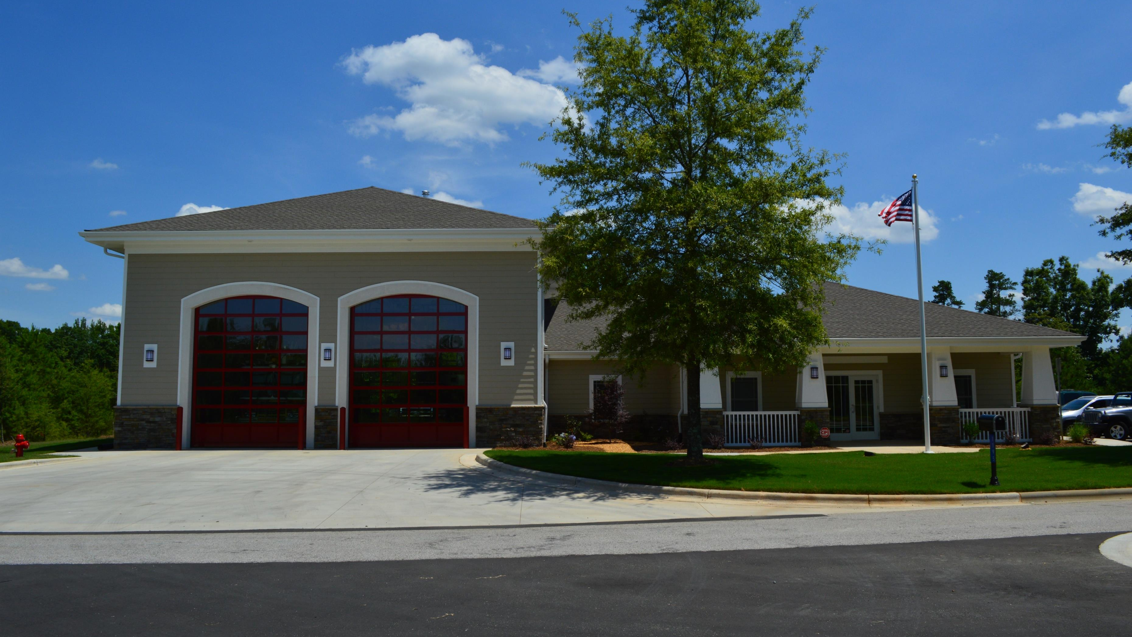
Tega Cay Fire Dept.
2021 Year End Review

Slide 2
Fire Incident Type Breakdown
100 - Fire | 32
200 - Over Heat, Over Pressure, Explosion | 4
300 - EMS | 518
400 - HAZMAT | 18
500 - Service Call | 67
600 - Good Intent | 209
700 - False Alarm | 166
800 - Natural Disaster | 3
900 - Special Incident | 3
Totals | 1020

Slide 3
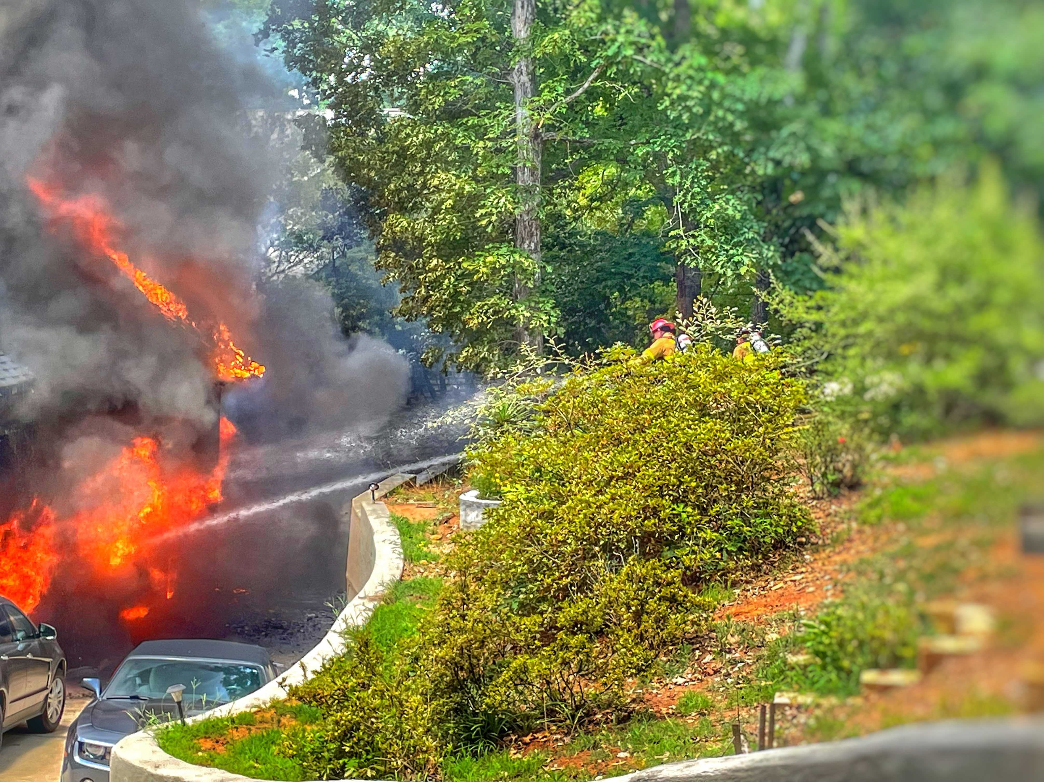
Training
2021 Stats
  In 2021 the Tega Cay FD recorded 6140 training hours.
Projections for FY2022
  High Angle
  Confined Space
  Swift Water/Boat Ops
  Flat Water Boat Operations
  ISO Compliant Classes
  EMT

Slide 4
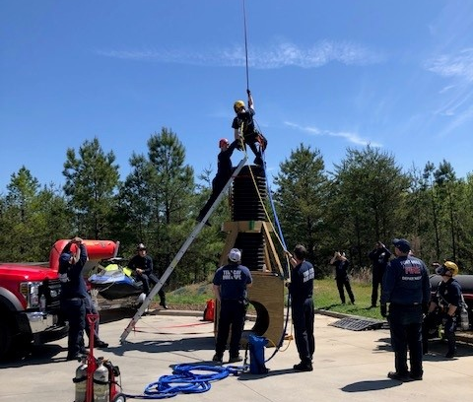
Initiatives
Events
EMS
Response
Education
Incident Action Plans
Community Involvement
Training
Grants

Slide 5
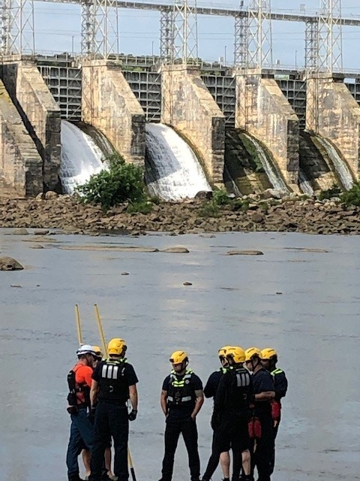
Initiatives
Fire and Medical Management
  Preplans
  Technical Review, Inspections and Enforcement
  Fire and Medical Records Management
Informational Platform Development
  Operations and Administration
  COVID Staffing Impacts
Grants

Slide 6

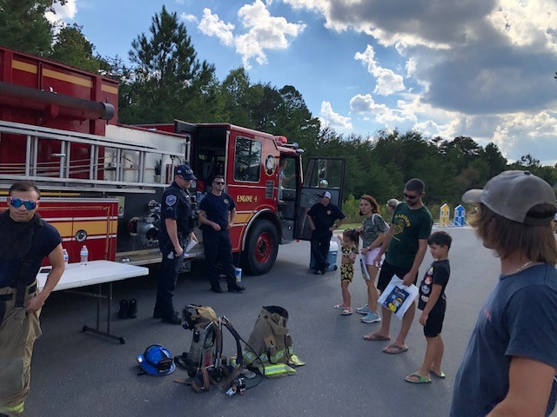
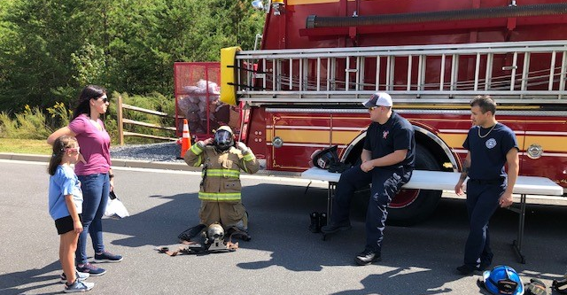
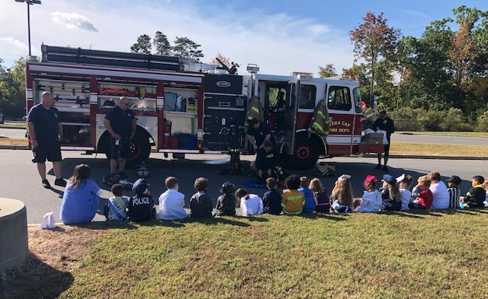
Education
Fire Safe City
Fire Safety Messaging
  18355 views on Social Media
Read, Interact & Educate

Slide 7
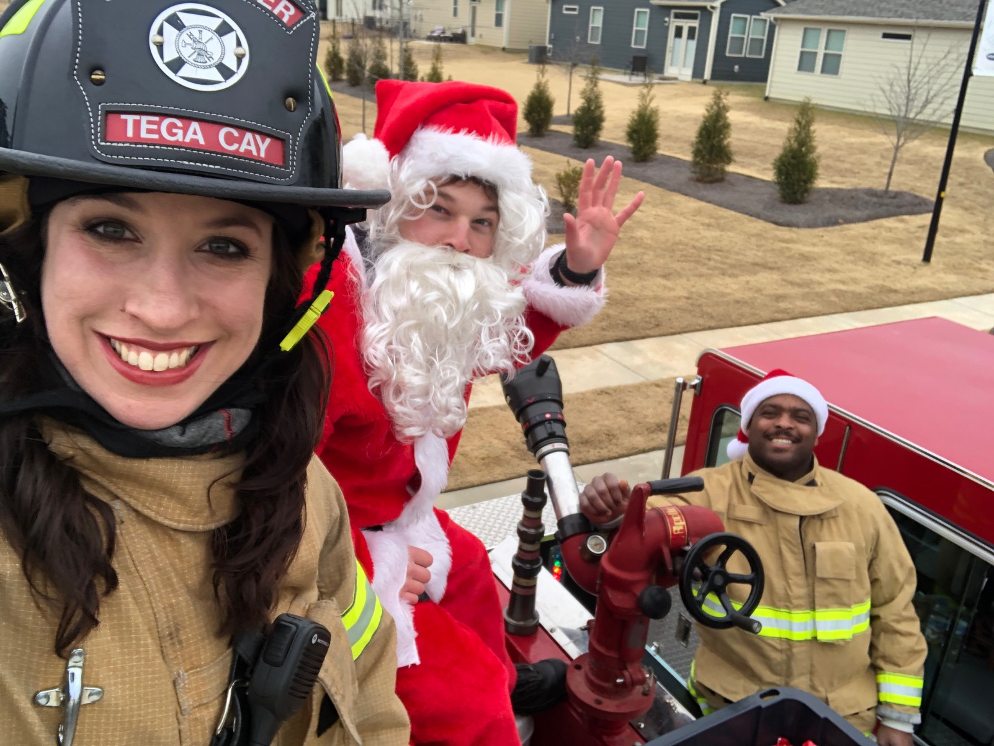
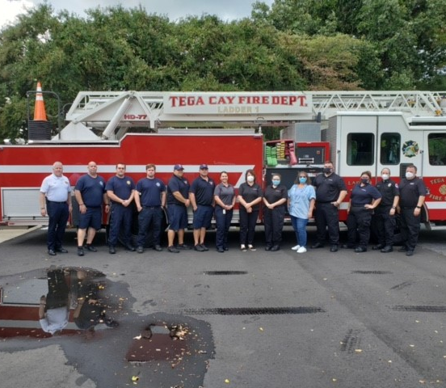
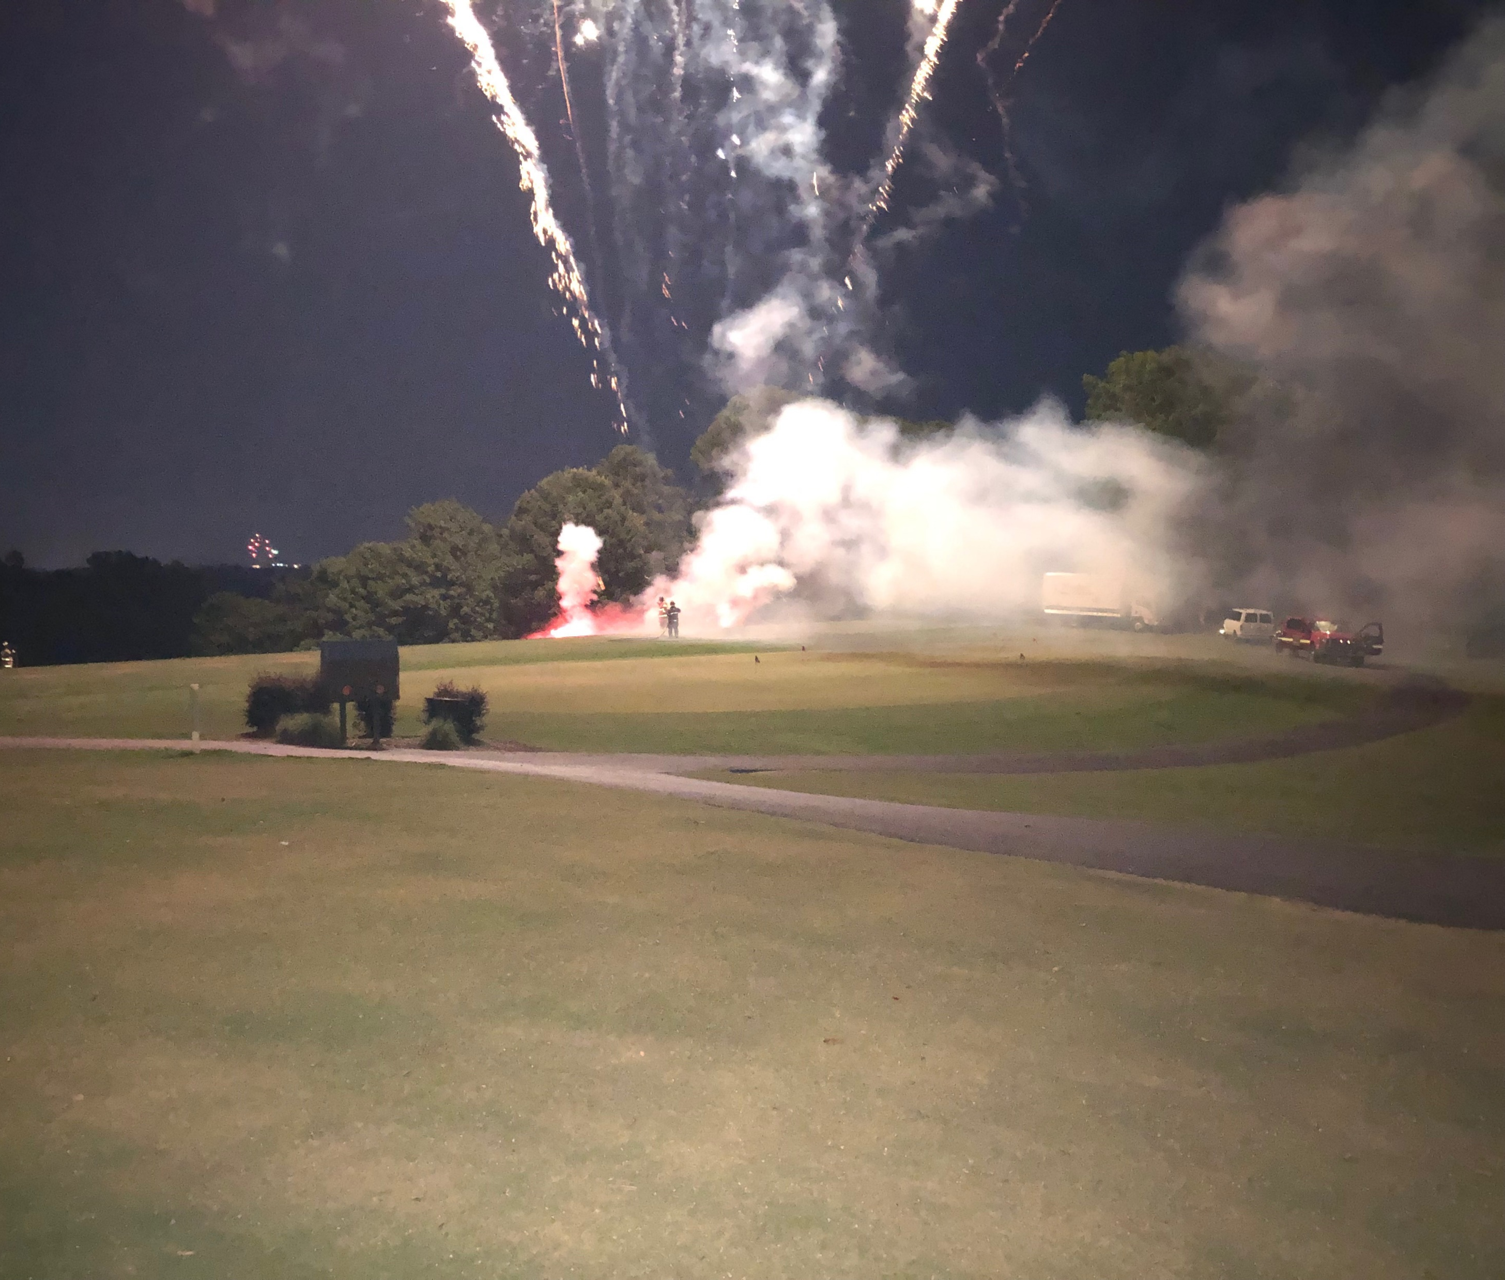
Community Involvement
City Events
  July 4th
  Veteran’s Day
  Shop with a Hero
  Concert Series
Fire Department
  Smoke Alarm Blitz
  Virtual Story Time
  Open House
  9-11 Remembrance
  Santa in the Cay

Slide 8
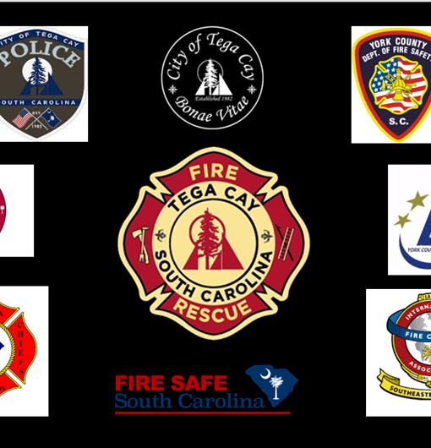
Partnerships
City Departments
County Agencies
  Piedmont EMS
York County Fire Service
Emergency Management
SC State Agencies
  CRR – Fire Safe City
  SC State Fire Academy
  SC Chief’s Association
National and International
  International Assn. of Fire Chief’s
  International Code Council
  National Fire Protection Agency

Slide 9
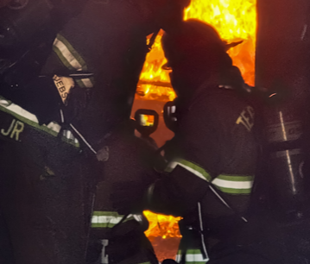
New for 22
Educational Outreach
EMS Service Enhancement
Technical Rescue Training and Capability
  Confined Space
  Water Rescue
  High Angle
ISO Inspection

